Slide 1
JWST mission status
Colin Jacobs
JWST MASTER CLASS MELBOURNE 2022

Slide 2
Acknowledgements
All along this presentation you will see results from work conducted by a large number of teams in Europe, USA and Canada.
Most elements of this presentation are based on existing presentations prepared by other members of the JWST project, the instrument teams and STScI.

Slide 3
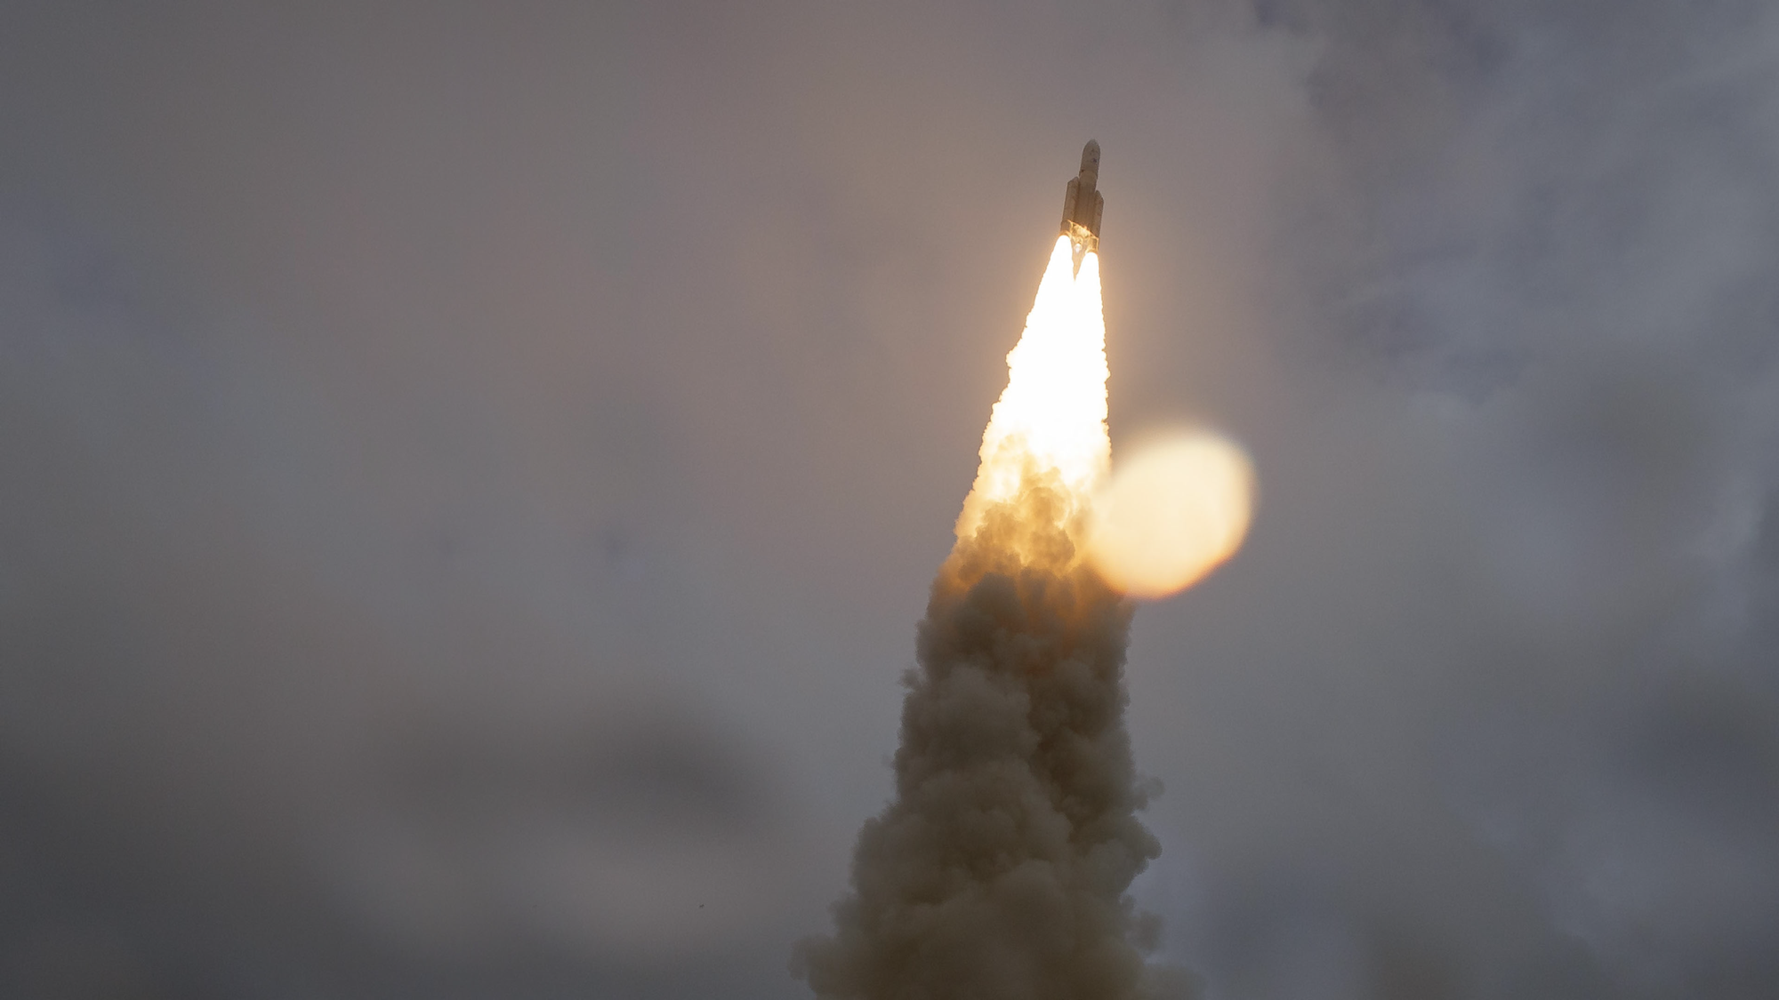
Lift Off!
Notes:
In the pre-dawn hours of Saturday, December 25, 2021, eyes around the world were on the sky.
NASA’s James Webb Space Telescope launched at 7:20 a.m. Eastern Standard Time on an Ariane 5 rocket from Europe’s Space Centre in French Guiana, South America.
Webb is the world’s largest and most complex space science observatory. It will study infrared light from celestial objects with much greater clarity than ever before.
Webb is the scientific successor to NASA’s iconic Hubble and Spitzer space telescopes, built to complement and further the scientific discoveries of these and other missions.
Because infrared light travels through dense gas clouds that block visible light, Webb will reveal previously hidden regions of the universe, helping us solve mysteries in our solar system, look beyond to distant worlds around other stars, and probe the mysterious structures and origins of our universe and our place in it.
[Note to presenter: We recommend pausing your presentation to play the launch video from 0:00-1:15]
__________________________
Resources:
Launch news release: https://webbtelescope.org/contents/news-releases/2021/news-2021-068
Launch video: https://webbtelescope.org/contents/media/videos/2021/068/01FRV8GH9C7ZJP2FAAJEEMQCPZ
Launch image: https://webbtelescope.org/contents/media/images/2021/068/01FQRWPPYBN2QP96MXJGMT5TRE?news=true
Where Is Webb? interactive:
https://www.jwst.nasa.gov/content/webbLaunch/whereIsWebb.html
Full launch broadcast:
https://www.youtube.com/watch?v=7nT7JGZMbtM
Webb Flickr album: https://www.flickr.com/photos/nasawebbtelescope/albums/72157720000770033
__________________________
Image Credit: NASA, Bill Ingalls
https://www.flickr.com/photos/nasawebbtelescope/51787852384/in/album-72177720296738159/

Slide 4
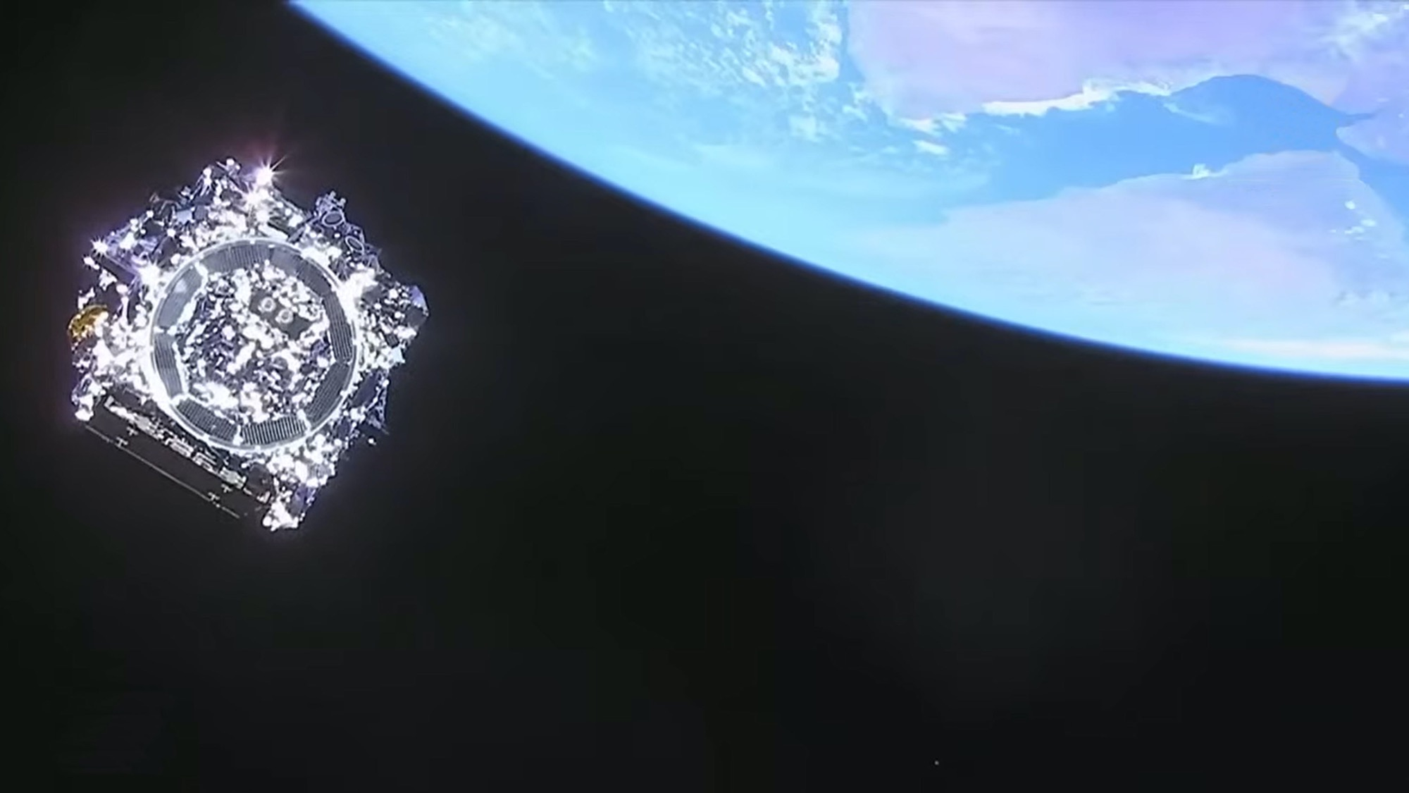
Webb’s Journey Begins
Notes:
The Ariane 5 rocket that carried Webb performed as expected, separating from the observatory 27 minutes into the flight.
At this point, engineers in Webb’s Mission Operations Center at the Space Telescope Science Institute in Baltimore, Maryland, took control.
__________________________
Resources:
Last view of the telescope (still image) from news release: https://webbtelescope.org/contents/media/images/2021/068/01FQRVPP8W778RA3TMD3TTBQ0H?news=true
Last view of Webb (video):
https://svs.gsfc.nasa.gov/14062#32370
Launch news release: https://webbtelescope.org/contents/news-releases/2021/news-2021-068
Image Credit: NASA, ESA
https://webbtelescope.org/contents/media/images/2021/068/01FQRVPP8W778RA3TMD3TTBQ0H

Slide 5
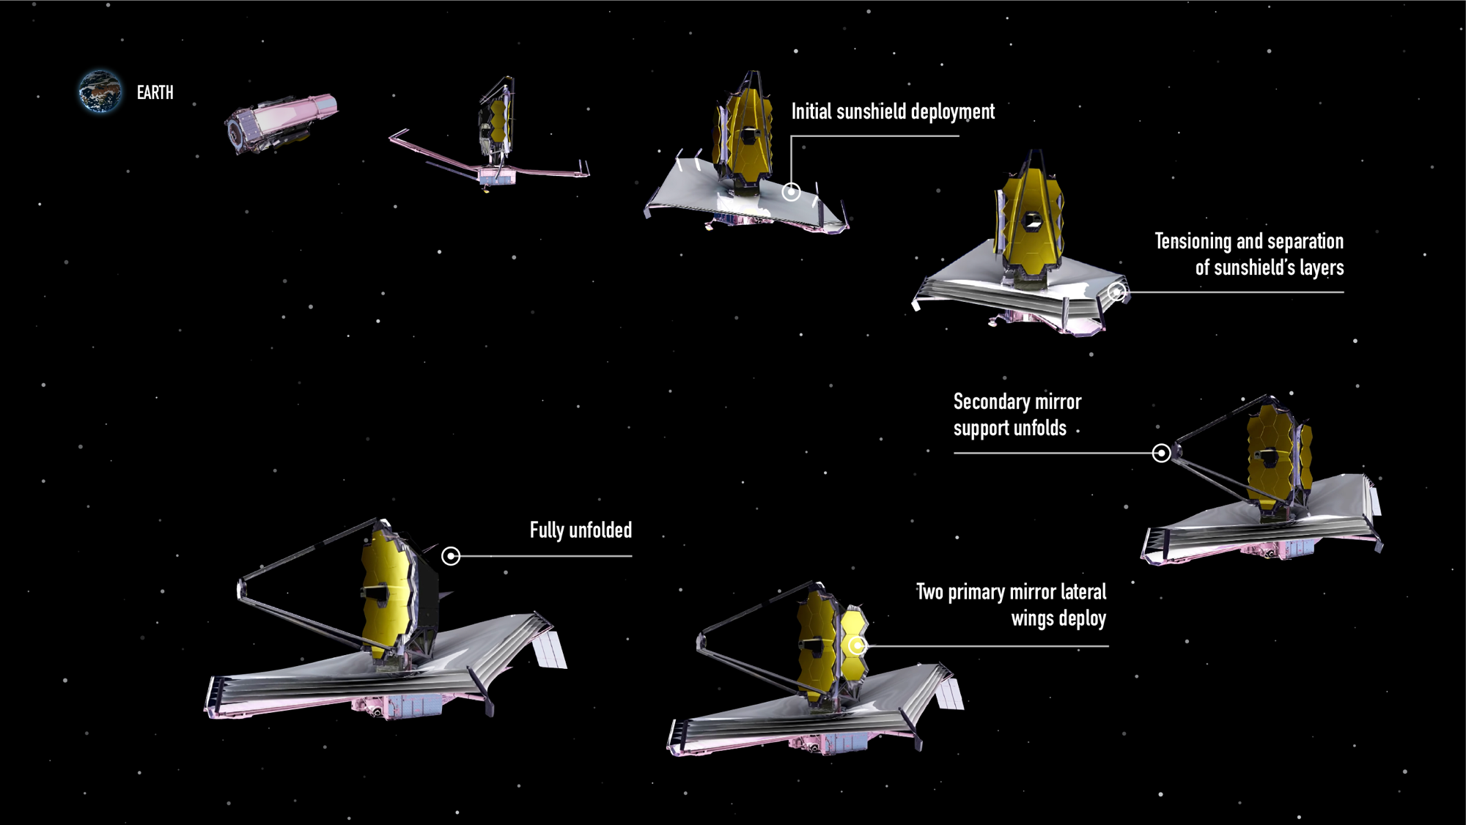

Webb’s Unfolding Sequence
Notes:
Engineers in Webb’s Mission Operations Center initiated and oversaw a carefully orchestrated series of major deployments.
After launch, Webb slowly unfolded while traveling to a location approximately 1.5 million kilometers (1 million miles) from Earth known as the second Sun-Earth Lagrange point (L2), a journey that took about a month.
Steps included:
Deploying, tensioning, and separating Webb’s sunshield, a five-layer, diamond-shaped structure the size of a tennis court,
Extending its secondary mirror support structure, and
Unfolding its primary mirror, which has a honeycomb-like pattern of 18 hexagonal, gold-coated mirror segments.
Throughout the next five months, engineers and scientists carefully activated and confirmed each and every instrument worked properly.
What made these innovations possible?
__________________________
FAQ:
Why do we have to wait so long between Webb’s launch and its first images?
In the six months after launch, Webb underwent a complex commissioning process. This included:
Deployments: This began when the telescope launched, on December 25, 2021, and continued for about 30 days. In a series of steps, Webb unfolded from its compact launch configuration. This included deploying, tensioning, and separating Webb’s sunshield, extending its secondary mirror support structure, and unfolding the wings of the primary mirror.
Telescope mirror alignments: This began just a month after launch and continued for about three months. Teams aligned Webb’s 18 hexagonal mirror segments so that they work together as one and are in focus for all of Webb’s four science instruments.
Science instrument calibrations: This began about four months after launch and continued for approximately two months. Webb’s instruments underwent a series of calibrations and tests. Engineers and scientists tested each mode to verify they are working as expected, understand their performance, and learn how to optimally extract science information.
During the deployment and alignment phases of commissioning, Webb cooled to its operating temperature. This slow, controlled cooling was necessary to prevent water that was outgassing from Webb to form ice on Webb’s optics and detectors and cold radiator surfaces, which would degrade the telescope’s performance.
More information: https://www.planetary.org/articles/jwst-first-images
Resources:
Webb’s unfolding sequence: https://webbtelescope.org/contents/media/images/01FJHQXZNXV0GWWJMCX69J57FD
Detailed post-launch deployment timeline: https://webbtelescope.org/contents/media/images/4180-Image
Article about aligning Webb’s mirrors: https://www.nasa.gov/feature/goddard/2017/aligning-the-primary-mirror-segments-of-nasa-s-james-webb-space-telescope-with-light
Webb’s orbit and view of the sky: https://webbtelescope.org/news/webb-science-writers-guide/telescope-overview
Video of Webb’s deployment sequence: https://www.youtube.com/watch?v=RzGLKQ7_KZQ
Illustration Credit: NASA, ESA, and J. Kang (STScI)
https://webbtelescope.org/contents/media/images/01FJHQXZNXV0GWWJMCX69J57FD

Slide 6
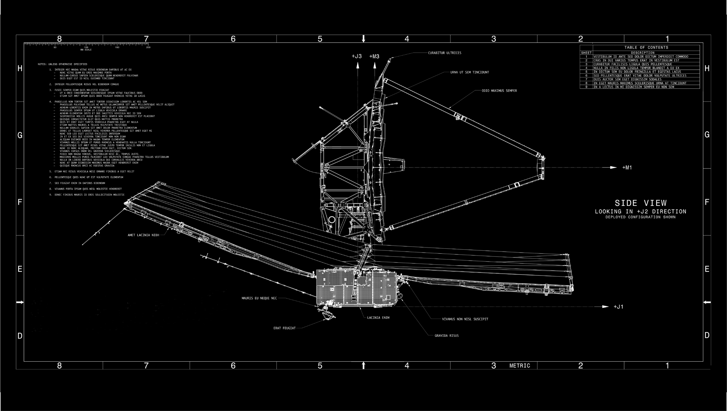
A Feat of Engineering
Notes:
Teams working on Webb designed several innovative and powerful new technologies that make its ambitious science goals possible.
Webb has specialized optics to align its mirrors, detectors that can capture and separate light from hundreds of sources at once, and custom thermal control systems.
The engineers who created these technologies made Webb the most sophisticated and complex space science telescope ever launched. And their diligent, hard work was easy to spot once Webb was in space.
_________________________
In-depth detail about the engineering:
Webb’s tennis-court-sized sunshield was deployed by 139 tiny mechanical motors called actuators, with the addition of eight motors, and thousands of other components, which unfolded and stretched the five membranes of the sunshield into its final taut shape. Every single movement was orchestrated precisely—and each one performed exactly as expected. Webb is a huge engineering success.
Webb’s primary mirror has 18 mirror segments that are adjusted to form a single, perfect focus. Each mirror segment has several actuators, or tiny mechanical motors attached to the back, allowing operators to independently move and adjust each mirror. Engineers conducted this complex alignment very carefully by executing tiny, precise movements for every segment.
Resources:
How Big Is Webb? article: https://webbtelescope.org/resource-gallery/articles/pagecontent/filter-articles/how-big-is-webb
Article about Webb innovations: https://www.jwst.nasa.gov/content/about/innovations/index.html
Webb Science Writer’s Guide Instrument Overview: https://webbtelescope.org/news/webb-science-writers-guide/telescope-overview
February 11, 2022 blog post: Beginning of mirror alignment, first Webb “selfie”:
https://blogs.nasa.gov/webb/2022/02/11/photons-received-webb-sees-its-first-star-18-times/
Webb science goals:
https://webb.nasa.gov/content/science/index.html
Image Credits: NASA

Slide 7
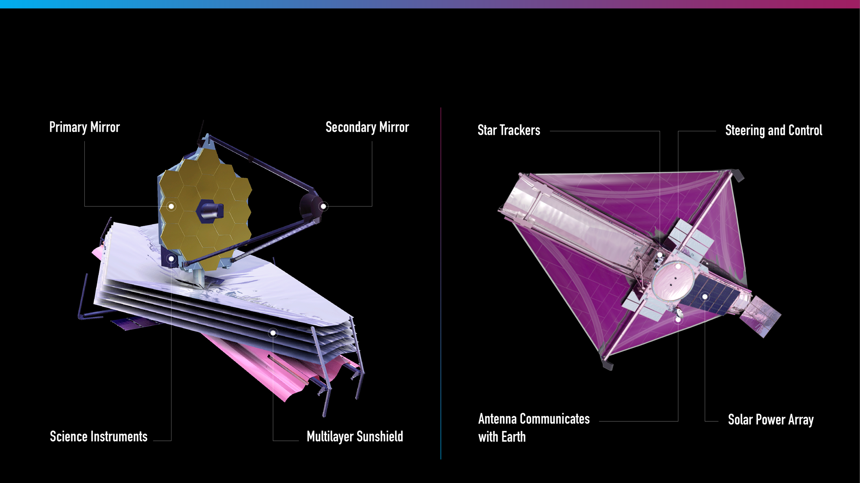
Observing Side
Sun-Facing Side
Notes:
The lower part of Webb, where its five-layered sunshield is, faces the Sun. This is where its equipment that does not need to be cooled, like its solar panel, antennae, computer, gyroscopes, and navigational jets, are.
Its tennis court-sized sunshield protects Webb from external sources of light and heat, which ensures it can detect faint infrared light from very distant objects.
It’s very important for its observing side, where all of Webb’s instruments are, to be very, very cold.
Webb’s science instruments are housed behind the mirror, separated by the sunshield from the warm communications and control technology.
Webb needs both passive and active cooling.
Its five-layered sunshield provides passive cooling. The first layer of the sunshield is two-thousandths of an inch (0.005 centimeters) thick, while the other four layers are only one-thousandth of an inch thick.
Let’s take a look at Webb’s instruments in a bit more detail.
__________________________
In depth:
Sunshield’s sun-facing layer estimated maximum temperature: ~400 K (260°F, 125°C)
Innermost layer of the sunshield estimated minimum temperature: ~40 K (–390°F, –235°C)
Keeps science instruments and mirrors passively cooled to 40 K (roughly –390°F, –235°C)
There is also a cryocooler, essentially a sophisticated refrigerator or air conditioner, to support one of the instruments (MIRI). This is the active cooling element that cools MIRI to approximately 7 K (–447°F, –266 °C).
Maintaining these temperatures ensures that Webb can gather a greater range of infrared light in space.
Without cooling, the only thing that Webb would see would be itself!
Since warm things glow in infrared light, Webb has to be cold or else its self-emission would produce enough background light that it would overwhelm faint sources. The colder Webb is, the fainter things it can see.
Resources:
Webb Science Writers’ Guide: https://webbtelescope.org/news/webb-science-writers-guide/telescope-overview
Webb’s Observing Side and Sun-Facing Side: https://webbtelescope.org/contents/media/images/4197-Image
Technical details: https://jwst-docs.stsci.edu/jwst-general-support/jwst-background-model
Image Credits: NASA, ESA, and J. Kang (STScI)

Slide 8
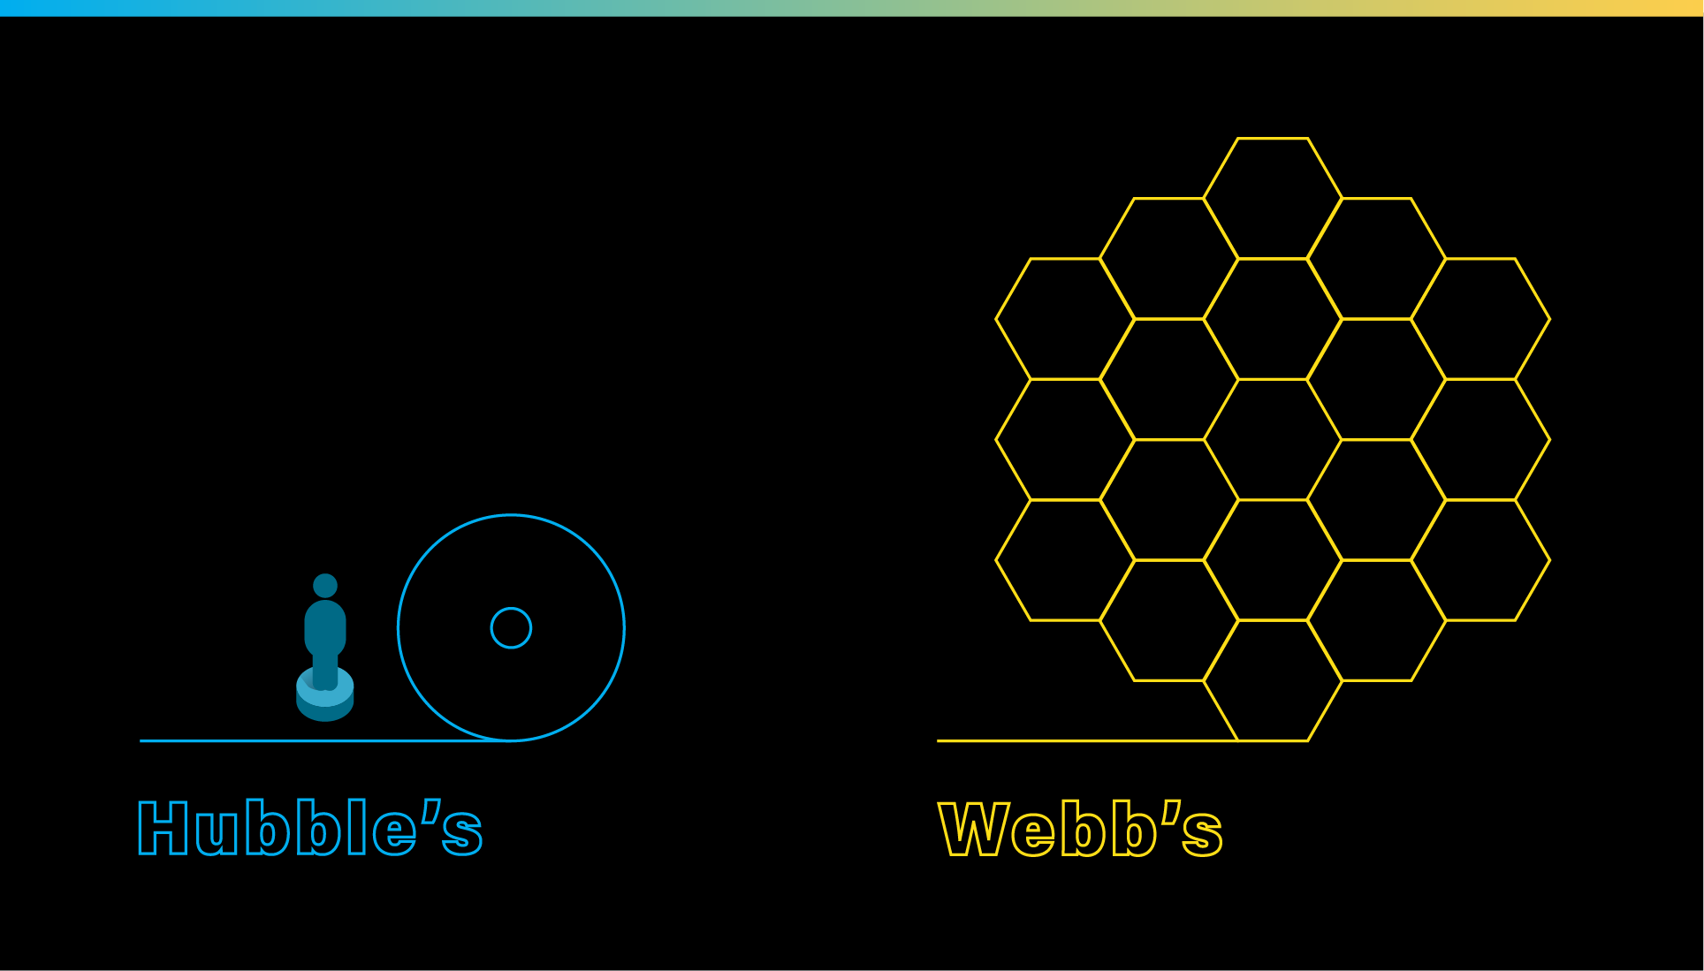
Capturing Faint, Infrared Light
PRIMARY MIRROR
PRIMARY MIRROR
Notes:
Webb has a 6.6-meter (21.7-foot) diameter primary mirror. It’s quite large—and there are several reasons why.
For context, Hubble's mirror is much smaller, at 2.4 meters (7.8 feet) in diameter.
Webb has to have a bigger mirror to capture high-resolution, Hubble-like details in infrared light.
Its mirror also needs to be stable at very cold temperatures—40 K (roughly –390°F, –235°C), which is why it is made of beryllium, which is six times stronger than steel and two-thirds the density of aluminum.
There are 18 hexagonal segments. They are hexagons so the mirrors can be adjusted to align to form a circular shape.
Each segment is coated in a very thin layer of gold—about 1,000 atoms thick! Gold was selected because it is the best reflector of infrared light.
Webb’s mirrors are like a bucket that collect light that’s immediately sent to its instruments. The more infrared light they gather, the more we can learn about the universe!
__________________________
Resources:
Webb’s mirrors: https://webbtelescope.org/news/webb-science-writers-guide/telescope-overview
https://webbtelescope.org/contents/media/images/01F6QV6RND28VX2T20V4PPAGMS
Hubble’s mirrors: https://hubblesite.org/mission-and-telescope/the-telescope
Video comparing Webb and Hubble’s mirrors: https://svs.gsfc.nasa.gov/13521
Video of the alignment of Webb’s primary mirror segments: https://svs.gsfc.nasa.gov/12895
Similar illustration: https://webbtelescope.org/contents/media/images/4181-Image
Video, “Hubble and Webb: Friends in the Sky”: https://webbtelescope.org/contents/media/videos/1279-Video
Illustration Credit: NASA, ESA, and J. Kang (STScI)

Slide 9
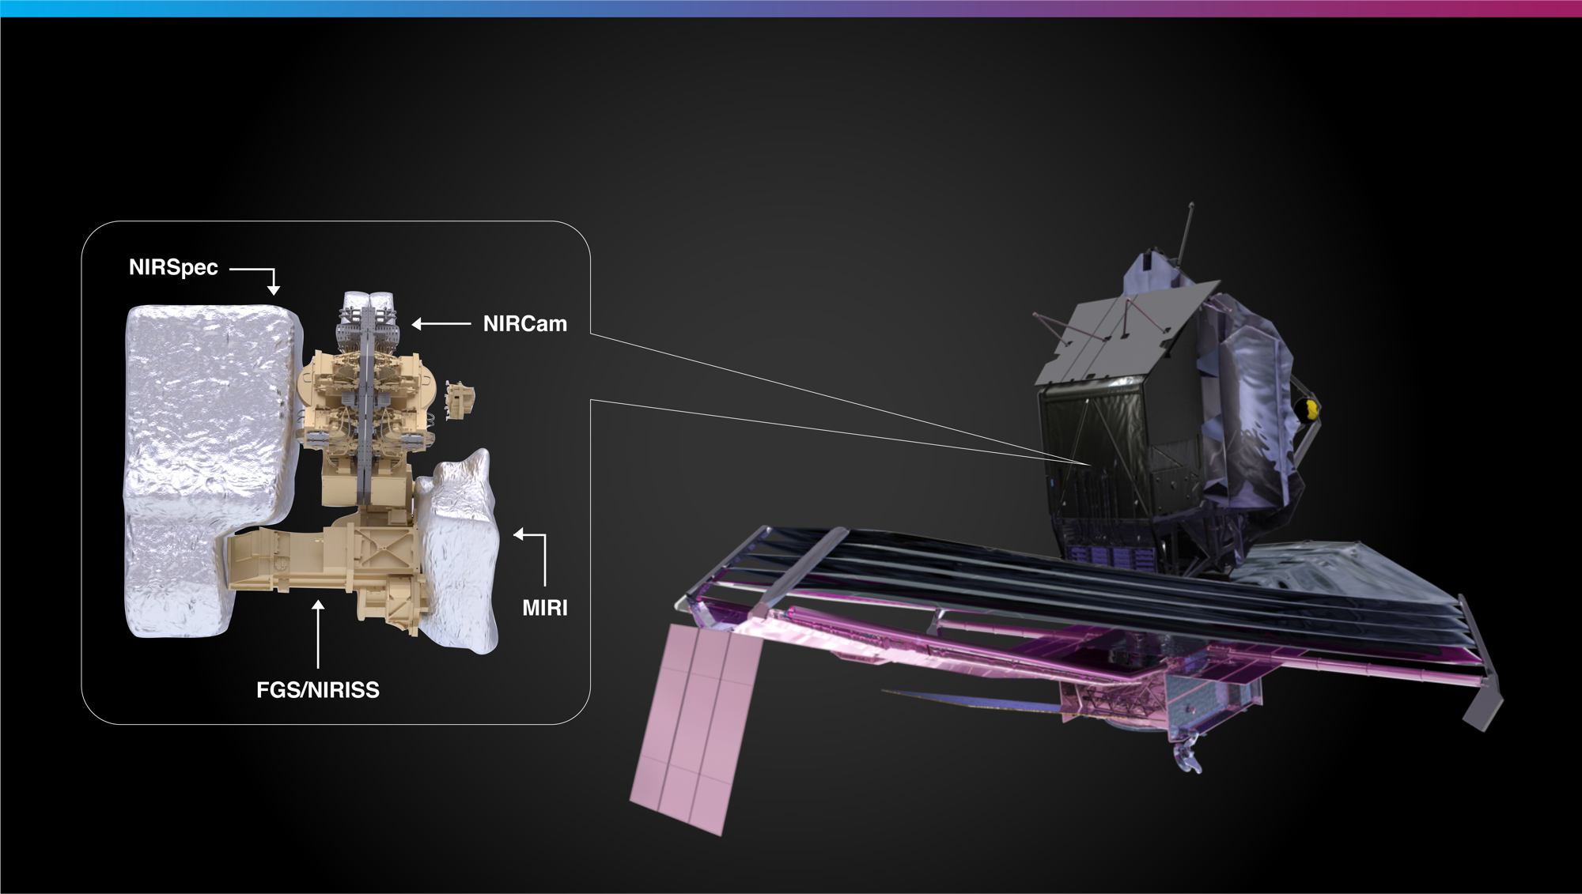
Webb’s Science Instruments
Notes:
Each instrument is like a Swiss army knife of more specialized components, with multiple ways of observing.
Although some instruments are more suitable than others for observing specific types of targets, all four can be used for investigations of the wide variety of objects that make up the universe, including planets, stars, nebulae, and galaxies.
__________________________
Instruments in depth:
Webb’s four science instruments are sensitive to a range of infrared light.
The Near-Infrared Spectrograph, or NIRSpec, is one of Webb’s versatile tools for near-infrared spectroscopy, which spreads out light into its component wavelengths like a rainbow. This allows researchers to study the composition of objects across the universe. This instrument has the first multi-object spectrograph in space, known as a microshutter array. It can capture individual spectra of dozens of objects at once, making it ideal for efficiently studying many distant, faint galaxies.
Webb’s Near-Infrared Imager and Slitless Spectrograph is combined with its Fine Guidance Sensor (NIRISS/FGS). NIRISS also gathers spectra—and photographs the universe at near-infrared wavelengths. It can study the composition of exoplanets’ atmospheres, observe distant galaxies, and examine bright objects that are very close together. FGS allows Webb to point precisely, so that it can obtain high-quality images.
Next up is the Near-Infrared Camera, or NIRCam, Webb’s primary imager or camera. It delivers high-resolution imaging and spectroscopy for a wide variety of investigations. It can detect light from the earliest stars and galaxies that are in the process of formation, stars in nearby galaxies, young stars in the Milky Way, and objects from a distant region of our solar system called the Kuiper Belt. It also can track the motion of exoplanets as they orbit their star.
The Mid-Infrared Instrument, or MIRI, is another powerhouse. It can take images and gather spectra—and it covers longer and redder infrared wavelengths of light. As the only mid-infrared instrument, astronomers rely on MIRI to study cooler objects like debris disks around stars, which emit most of their light in the mid-infrared, and extremely distant galaxies whose light has been stretched into the mid-infrared over time.
Spectrum definition:
A spectrum spreads out light. By looking at the resulting patterns in brightness across the spectrum, we can learn about the composition, surface temperature, density, and movement of objects in space.
Resources:
Overview of instruments: https://webbtelescope.org/news/webb-science-writers-guide/webbs-scientific-instruments
Individual instrument infographics:
NIRCam: https://webbtelescope.org/contents/media/images/01FA0SZSEW1TZ51BHG0EGW2EZP
NIRSpec: https://webbtelescope.org/contents/media/images/01FA0T08S2V810Y7ENZMGWTVDA
NIRISS: https://webbtelescope.org/contents/media/images/01FA0T0WM3X65FFXM0JBR4C5ZB
MIRI: https://webbtelescope.org/contents/media/images/01FA0SZA5HPXKRKH8Y6PKB10V1
Microshutter infographic
https://webbtelescope.org/contents/media/images/4673-Image
Eclipse/coronagraph animation: https://webbtelescope.org/contents/media/videos/2019/29/1210-Video
Webb’s Instrument Wavelength Coverage: https://webbtelescope.org/contents/media/images/4207-Image
Image Credit: NASA, ESA, and J. Kang (STScI)

Slide 10
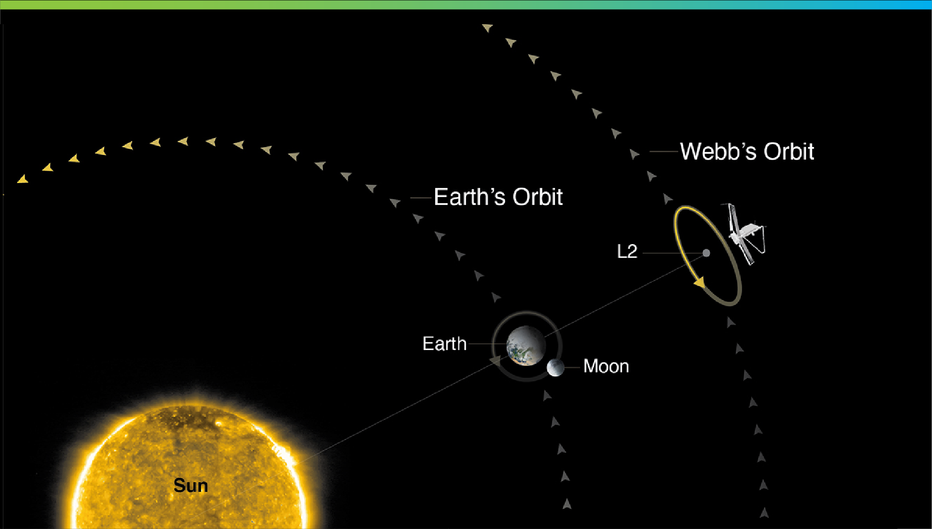

Where Is Webb’s Orbit?
Not to scale
Notes:
Webb orbits the Sun near the second Sun-Earth Lagrange point—often referred to as L2. This point is approximately 1.5 million kilometers (930,000 miles) from Earth, “behind” the Earth as viewed from the Sun. L2 moves in lockstep with the Earth as it rotates around the Sun, completing one orbit in one year.
Webb can’t orbit the Earth like Hubble, because the visible and infrared light from the Sun, Earth, and Moon would heat up the telescope’s mirror and scientific instruments, causing the telescope itself to glow in infrared light—and that would outshine the faint objects in space that Webb observes.
Webb’s sunshield always faces the Sun. This ensures its mirrors and instruments, which always face away from the Sun, are always cool.
At L2, Webb can maintain a safe distance from the bright light of the Sun, Earth, and Moon—while also remaining in contact with us on Earth.
__________________________
FAQ:
What is a Lagrange point?
Lagrange points, discovered by mathematician Joseph Louis Lagrange, are special equilibrium points for small objects (like a spacecraft or an asteroid) orbiting two much larger objects (like the Earth and the Sun). At these points in space, the gravity of the two large objects balance the orbital motion of the third object. Lagrange points can be used by spacecraft to reduce propellant consumption needed to remain in position.
There are five Lagrange points for any system, labeled L1 to L5. Of the five points, three are unstable and two are stable. The unstable Lagrange points—L1, L2, and L3—lie along the line connecting the two large masses. Spacecraft orbiting at these points need to perform station keeping to remain their orbits, by periodically expending small amounts of propellant. The stable Lagrange points—L4 and L5—occur at the apex of two equilateral triangles that have the large masses at their vertices. L4 leads the orbit of Earth and L5 follows.
See the diagram here: https://solarsystem.nasa.gov/resources/754/what-is-a-lagrange-point/
Webb orbits around the second Sun-Earth Lagrange point (L2). This point is approximately 1.5 million kilometers (930,000 miles) from Earth, “behind” the Earth as viewed from the Sun. All Lagrange points move in lockstep with the Earth as it rotates around the Sun, completing an orbit in one year.
Are there other spacecraft that orbit at L2?
Yes. There are several spacecraft that orbit or have orbited at L2. They include the Herschel Space Observatory, the Gaia space observatory, the Planck space observatory, and the Wilkinson Microwave Anisotropy Probe (WMAP).
Does Webb orbit exactly at L2?
No. Webb will orbit around L2, not sit stationary precisely at L2. If Webb were located exactly at L2, it would see the Sun eclipsed by the Earth, blocking the power it receives on its solar arrays. Webb loops around L2 in a six-month, tilted, elliptical orbit, which is slightly larger than the size of the Moon’s orbit around the Earth. This ensures that spacecraft never falls into the shadow of the Earth or the Moon—and remains charged. Here is a diagram of the obit to scale: https://www.flickr.com/photos/nasawebbtelescope/51886649707
What is Webb’s anticipated lifetime?
Webb will contain enough propellant for about 20 years of maneuvers at L2, and the Webb Science and Mission Operations Center at the Space Telescope Science Institute (STScI) will have the ability to adjust the science operations of the observatory to maximize potential as it ages. NASA engineered Webb so that all critical subsystems are dual or will degrade gracefully with age. For instance, the Near Infrared Camera (NIRCam) has two identical camera systems so that the optical quality can be maintained even if one fails.
How much of the sky can Webb see?
Over the course of six months, as Webb orbits the Sun with Earth, it has the ability to observe almost any point in the sky. Webb’s field of regard is limited to a 50-degree swath of the celestial sphere: About 39% of the sky is potentially visible to Webb at any given time. Because Webb must face away from objects that are warm and close enough to interfere with its ability to observe faint infrared light, it cannot observe the Sun, Mercury, Venus, Earth, the Moon, or other objects as they pass through the inner Solar System.
Can we can service Webb?
The quick answer is no. To meet Webb’s science goals, the telescope has to be far away from the heat of the Earth. This is why the telescope had to be so thoroughly tested before launch. This isn’t the first mission that is unserviceable. Other space telescopes, such as Spitzer and Herschel, successfully completed their missions in unserviceable orbits.
Resources:
Webb Science Writers’ Guide: https://webbtelescope.org/news/webb-science-writers-guide/telescope-overview
Article about Webb’s orbit, including illustrations and a video: https://webb.nasa.gov/content/about/orbit.html
Webb’s Orbit illustration: https://webbtelescope.org/contents/media/images/4201-Image
Additional detail about Webb’s orbit to help explain the details: https://www.ariane.group/en/news/how-lagrange-point-2-meets-james-webbs-checklist-for-an-ideal-home/
Video of Webb’s orbit:
https://webbtelescope.org/contents/media/videos/01F51C6VAPFHS6ZK5R29G2NDVG
Video about Webb’s field of regard: https://webbtelescope.org/contents/media/videos/1157-Video
Answers to frequently asked questions: https://www.jwst.nasa.gov/content/about/faqs/faq.html
Image Credit: STScI
https://webbtelescope.org/contents/media/images/4201-Image

Slide 11
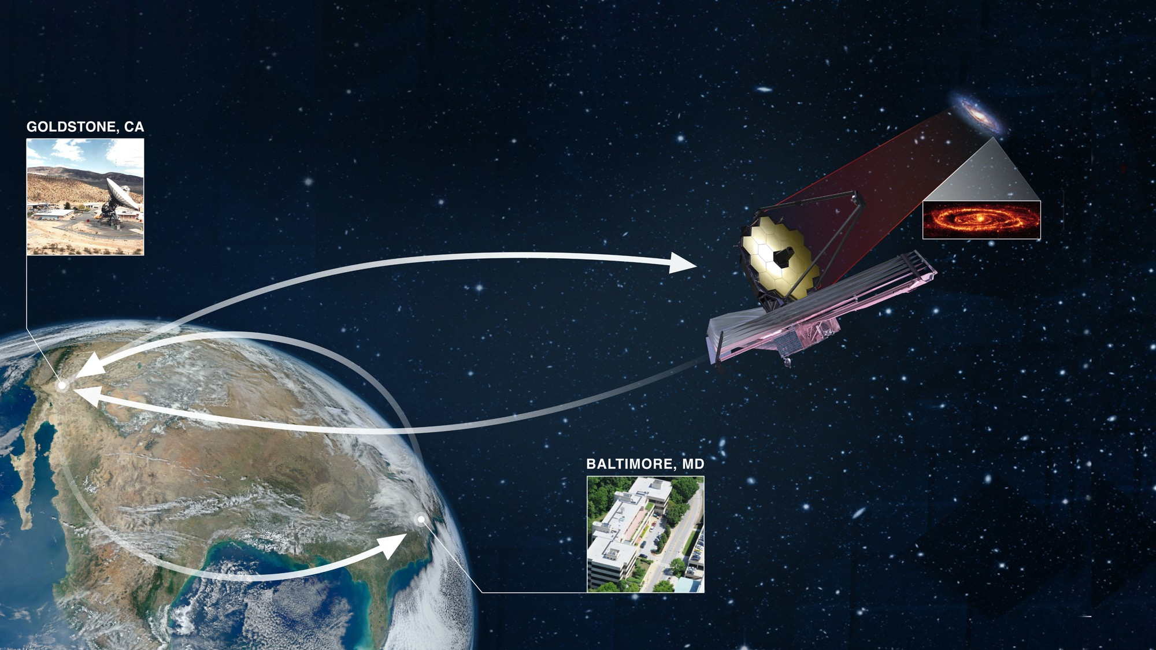
How We ‘Talk’ to Webb
Notes:
Every great relationship is based on excellent communication!
The Space Telescope Science Institute (STScI) in Baltimore, Maryland, plays a key role in communicating with Webb—STScI hosts Webb’s Mission Operations Center, where engineers and scientists command and control the telescope.
Commands from STScI travel to the Deep Space Network, or DSN, which transmits them to Webb.
Webb’s data are returned through the Deep Space Network to STScI, where they are processed, distributed to the scientific community, and added to STScI’s publicly accessible archive.
__________________________
FAQ:
How much data will Webb transmit each day?
Webb can downlink at least 57.2 gigabytes of recorded science data each day, with a maximum data rate of 28 megabits per second.
How long does data take to travel from Webb to Earth?
Traveling at the speed of light, it takes about 5 seconds for data to travel from Webb in its orbit around L2 to the Earth. All communications are routed through NASA’s Deep Space Network, with three ground stations located in Canberra, Australia, Madrid, Spain, and Goldstone, California.
Which frequencies do we use to communicate with the telescope?
S-band frequencies are used for command uplink, low-rate telemetry downlink, and ranging. Ka-band frequencies are used for high-rate downlink of science data and telemetry.
Resources:
Graphic shown on slide: https://webbtelescope.org/contents/media/images/01F6850HZ2K7FY8P8A8KBC54FQ
Details about how STScI will communicate with Webb (replace “testing” references with actual commands if you add these details to your presentation notes): https://www.stsci.edu/contents/annual-reports/2019/rehearsing-for-launch
Watch Webb’s data transmission: https://eyes.nasa.gov/dsn/dsn.html
Technical details about Webb’s communications system: https://jwst-docs.stsci.edu/jwst-observatory-hardware/jwst-spacecraft-bus/jwst-communications-subsystem
The Mikulski Archive for Space Telescopes (MAST), home to Webb’s data:
https://archive.stsci.edu/
Image Credit: NASA, ESA, CSA, Elizabeth Wheatley (STScI) https://webbtelescope.org/contents/media/images/01F6850HZ2K7FY8P8A8KBC54FQ

Slide 12
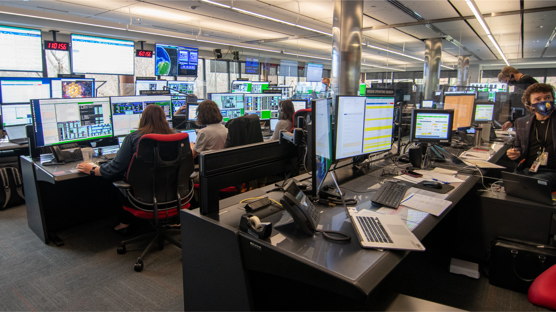
Commanding Webb
from Baltimore, Maryland
Notes:
Want to pretend you are sending commands to Webb? Imagine you’re in Webb’s Mission Operations Center at the Space Telescope Science Institute (STScI) in Baltimore, Maryland.
STScI’s engineers sit at the controls—they send commands to Webb, which the telescope executes. They are supported by scientists and team members from the mission’s partners. The team also continuously monitors the health of the telescope.
Engineers have controlled Webb since the telescope fully separated from its launch vehicle 27 minutes after liftoff.
They also initiated and oversaw all major deployments as Webb slowly unfolded while traveling to the second Sun-Earth Lagrange point (L2), which is approximately 1.5 million kilometers (1 million miles) from Earth.
During the first six months of 2022, engineers and scientists fully commissioned every instrument on Webb.
What is commissioning? It involves hundreds of precise, choreographed activities. First, engineers executed commands to carefully unfold the telescope’s mirrors. Then they aligned each mirror segment so they work together to produce one, clear image.
They also tested every mode on every instrument, taking images and spectra as they went, to ensure that everything works as planned.
And it does! This is a major feat that we can all be proud of.
This team prepared for years for these moments. And now, they are executing science proposals for astronomers who received time to observe with Webb.
__________________________
FAQ:
How long does data take to travel from Webb to Earth?
Traveling at the speed of light, it takes about 5 seconds for data to travel from Webb in its orbit around L2 to the Earth. All communications are routed through NASA’s Deep Space Network, with three ground stations located in Canberra, Australia, Madrid, Spain, and Goldstone, California.
Resources:
Overview of Webb’s commissioning activities from launch to the beginning of science operations: https://jwst.nasa.gov/content/webbLaunch/deploymentExplorer.html
Firsthand account from three members of the Flight Operations Team at STScI: https://www.stsci.edu/contents/annual-reports/2021/front-row-seats
2019 graphic article that shows how everyone collaborates in Webb’s Mission Operations Center (note that these graphics were created during rehearsals): https://www.stsci.edu/contents/annual-reports/2019/rehearsing-for-launch
2018 release about communications in the Mission Operations Center: https://webbtelescope.org/contents/news-releases/2018/news-2018-31
Video: “Seeing New Frontiers with NASA's James Webb Space Telescope”: https://universeunplugged.ipac.caltech.edu/video/ata-21-12-09
Baltimore Magazine article about STScI’s James Webb Space Telescope Science Policy Group Lead Astronomer Dr. Christine Chen: https://www.baltimoremagazine.com/section/gamechangers/jhu-astronomer-christine-chen-decides-who-will-use-james-webb-space-telescope/
Baltimore Magazine article, “Baltimore Scientists Unveil the Universe with the James Webb Space Telescope”: https://www.baltimoremagazine.com/section/sciencetechnology/baltimore-scientists-unveil-the-universe-with-james-webb-space-telescope/
Watch Webb’s data transmission: https://eyes.nasa.gov/dsn/dsn.html
Image Credit: NASA, (Jaclyn Barrientes) STScI.

Slide 13
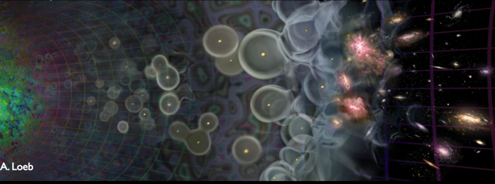
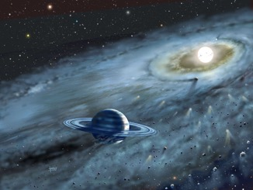
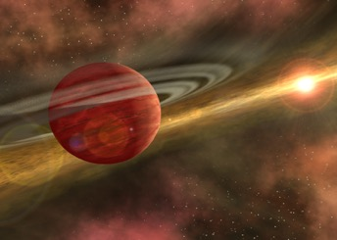
JWST – the mission in a few sentences
High-sensitivity, low-background, imaging, spectroscopic and coronagraphic capabilities over the 0.6-29 micron wavelength range.
Very powerful and versatile observatory with broad science goals.
From the first galaxies to our Solar system.

Slide 14
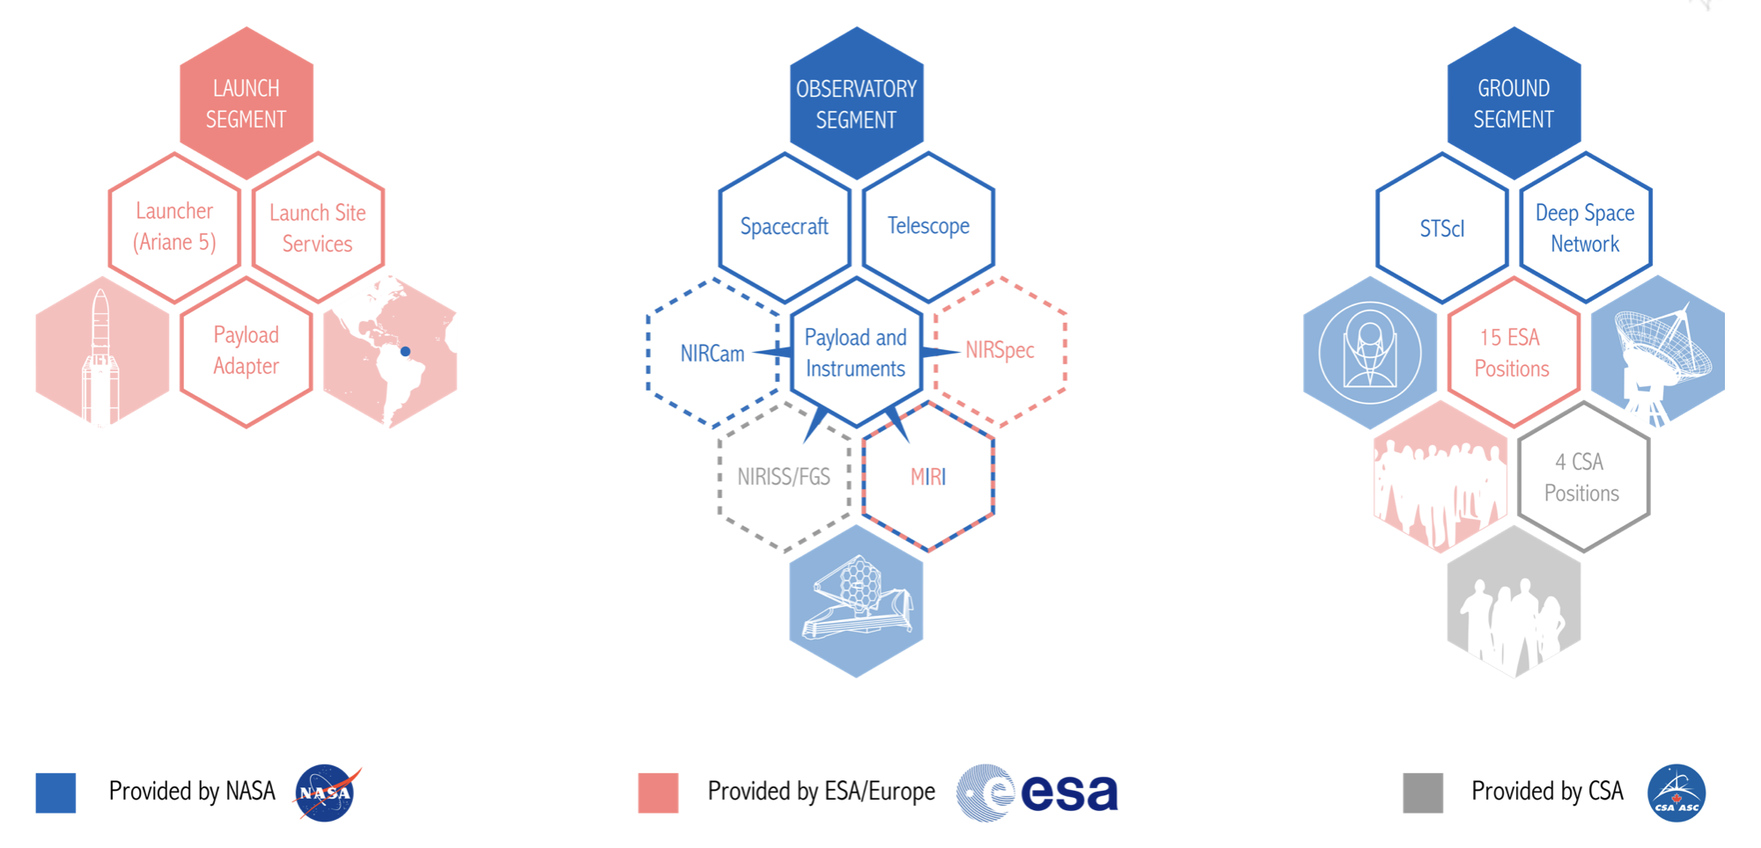
JWST – an international collaboration

Slide 15
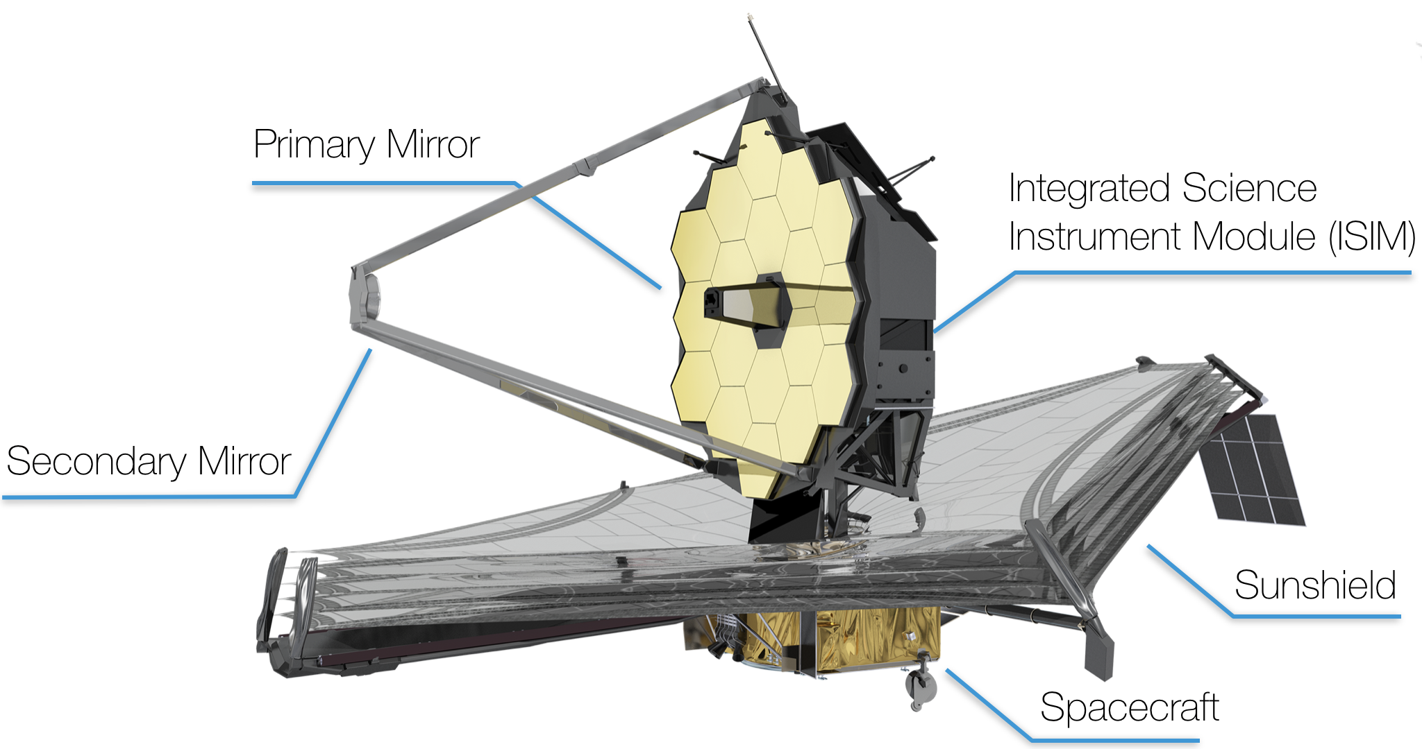
JWST – Main building blocks
JWST observatory
SCE = spacecraft + sunshield
OTIS = telescope + instruments

Slide 16
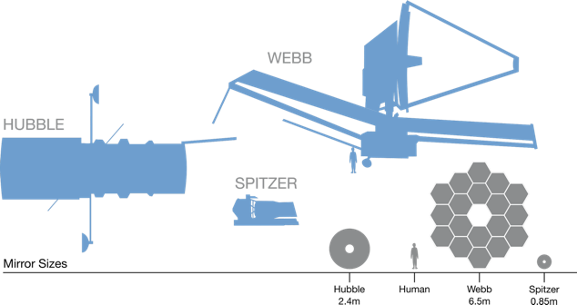
JWST – Main building blocks

Slide 17
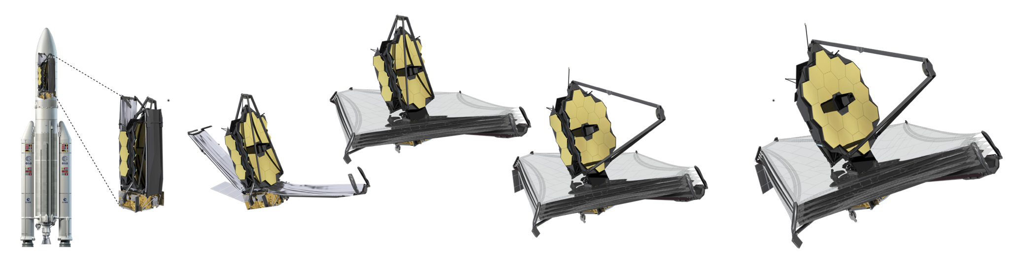
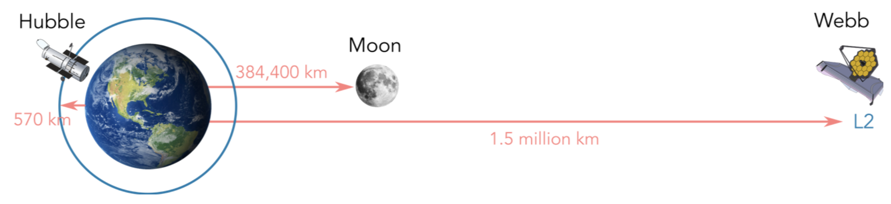
JWST – a deployable observatory

Slide 18
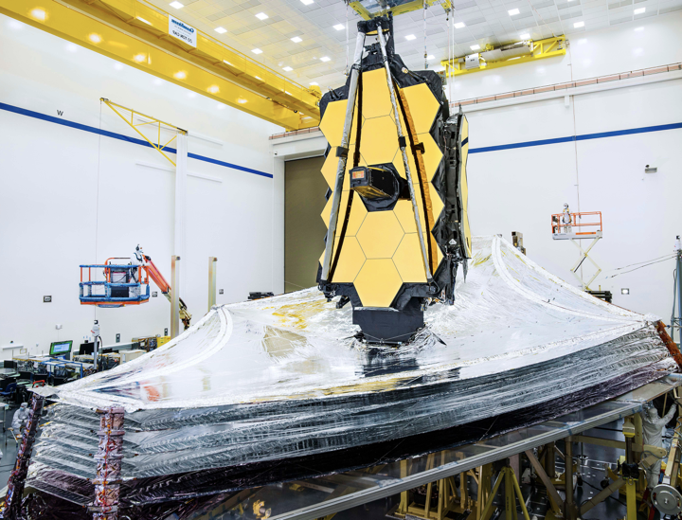
JWST – observatory status
A major, long awaited milestone was passed at the end of August 2019.
For the first time, all JWST elements were integrated together, the JWST “observatory” was born!
Credit: NASA/Chris Gunn

Slide 19
JWST – the mission in a few sentences
Flagship mission that will be one of the great observatories of the 2020s.
Often presented as the next step after the Hubble Space Telescope. The good news is that we expect JWST and HST to overlap (very complementary).
A partnership between NASA, ESA and CSA.
High-priority endeavor for the associated astronomical communities.
To be launched in March 2021 for a minimum mission duration of 5 years.
Enough consumables for at least 10 years.
6.5-meter diameter segmented telescope passively cooled to < 50K.
To be launched by an Ariane 5 rocket.
Orbit around the Sun-Earth L2 point.

Slide 20
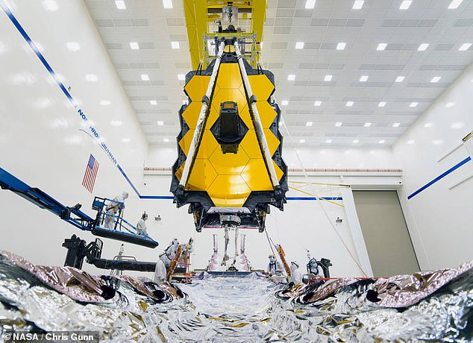
JWST – observatory status
Impressive image of OTIS (telescope and instrument) as it was slowly and carefully lowered to be installed on the SCE (spacecraft and sunshield) in August 2019.
Credit: NASA/Chris Gunn

Slide 21
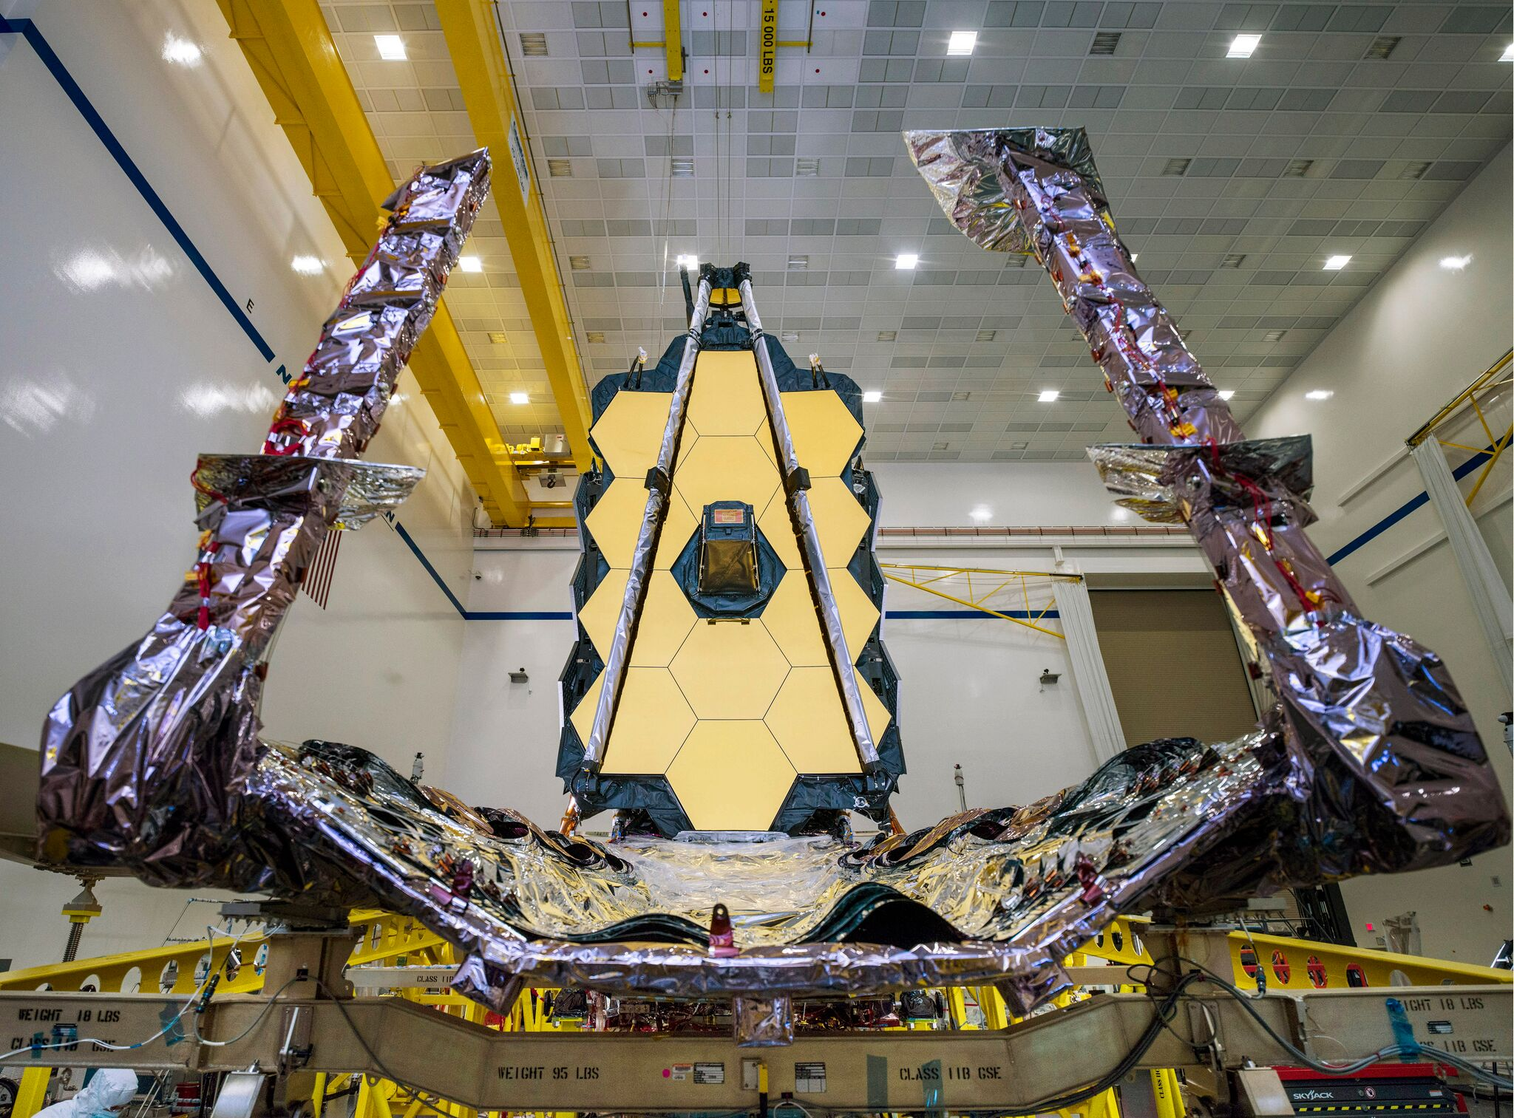
JWST – observatory status
But JWST still has a lot of activities planned before the observatory can be shipped to Kourou in French Guyana to be integrated on the Ariane 5 rocket.
2020 will be another busy year for the JWST team.
Credit: NASA/Chris Gunn

Slide 22
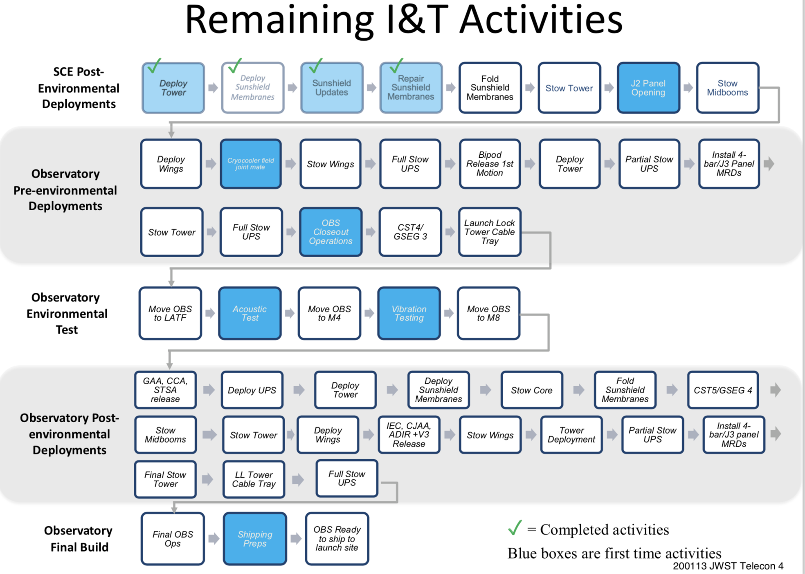
JWST – next steps
I&T = integration and testing
SCE = spacecraft and sunshield
From now…
First time activities highlighted in blue.
The vast majority of activities are not done for the first time.
Status 13 January 2020 – presentation E. Smith (NASA)
Checks before observatory testing
Major observatory-level test activities (mid-2020)
Final deployment and stowing tests
To the end of 2020!
Shipping!

Slide 23
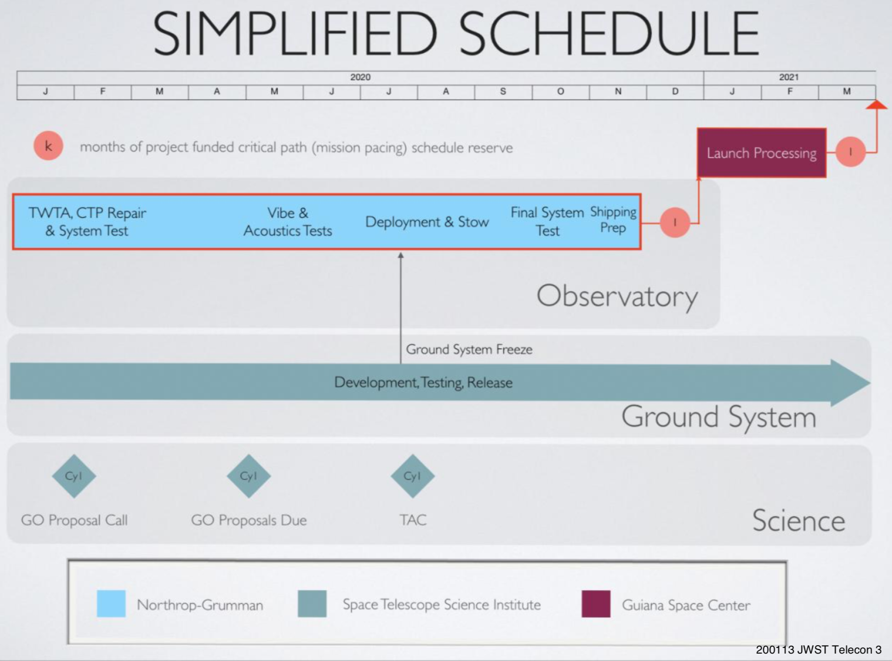
JWST – observatory status
Launch is still planned for March 2021 with the observatory arriving in Kourou at the end of 2020.
JWST still has some schedule margin (2 months) but schedule is tight.
Status 13 January 2020 – presentation E. Smith (NASA)

Slide 24
JWST status - conclusion
JWST is on track for a launch in March 2021!
2020 will be a very busy year for the JWST team as engineers and scientists work to ready it for its shipping to the launch site in French Guyana at the very end of the year!
Thanks for your attention.

Slide 25

The Big Reveal: Webb’s First Observations
Notes:
Drumroll, please!
This is what we’ve all been waiting for—Webb’s first images and data!
Six long months of anticipation following the excitement of Webb’s December 25, 2021 launch—not to mention years of new technology development and mission planning—are at an end. Now, we have our first look at what Webb can do with the release of its first full-color images and data. This is the first demonstration of Webb at its full power, ready to begin its science mission and reveal the hidden the infrared universe.
__________________________
Resources:
Webb’s science: https://webbtelescope.org/webb-science
Background about Webb’s first images and what comes next: https://webbtelescope.org/resource-gallery/articles/pagecontent/filter-articles/webbs-first-images
For a full array of Webb’s first images and spectra, including downloadable files, please visit: https://webbtelescope.org/news/first-images
Image Credit: NASA and J. Kang (STScI)

Slide 26
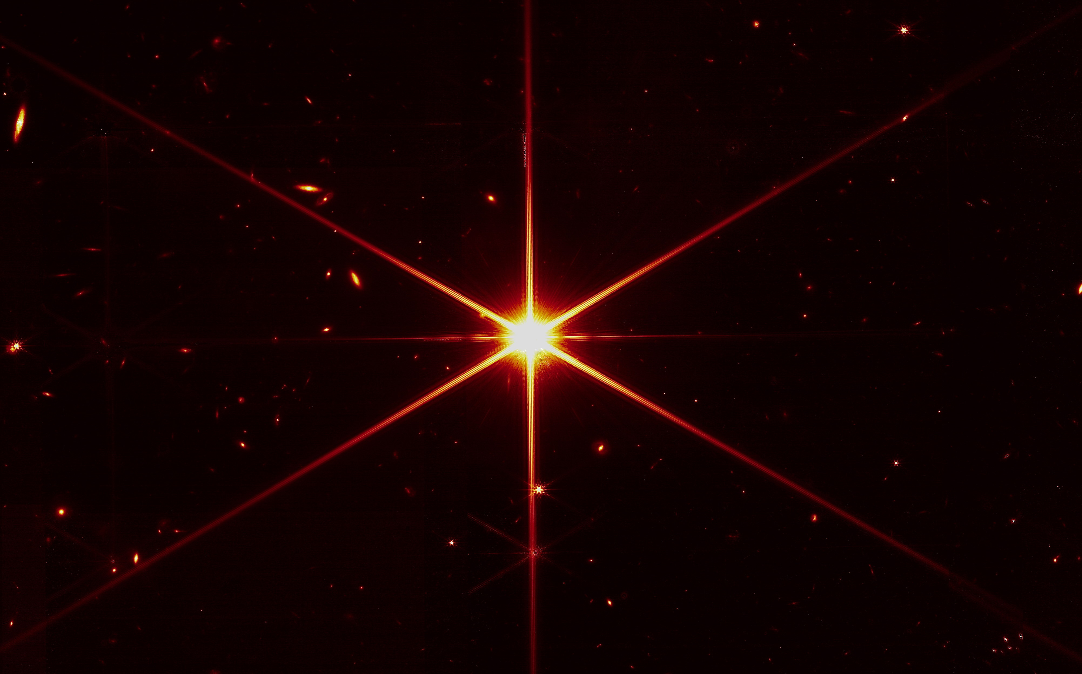
Notes:
Drumroll, please!
This is what we’ve all been waiting for—Webb’s first images and data!
Six long months of anticipation following the excitement of Webb’s December 25, 2021 launch—not to mention years of new technology development and mission planning—are at an end. Now, we have our first look at what Webb can do with the release of its first full-color images and data. This is the first demonstration of Webb at its full power, ready to begin its science mission and reveal the hidden the infrared universe.
__________________________
Resources:
Webb’s science: https://webbtelescope.org/webb-science
Background about Webb’s first images and what comes next: https://webbtelescope.org/resource-gallery/articles/pagecontent/filter-articles/webbs-first-images
For a full array of Webb’s first images and spectra, including downloadable files, please visit: https://webbtelescope.org/news/first-images
Image Credit: NASA and J. Kang (STScI)

Slide 27
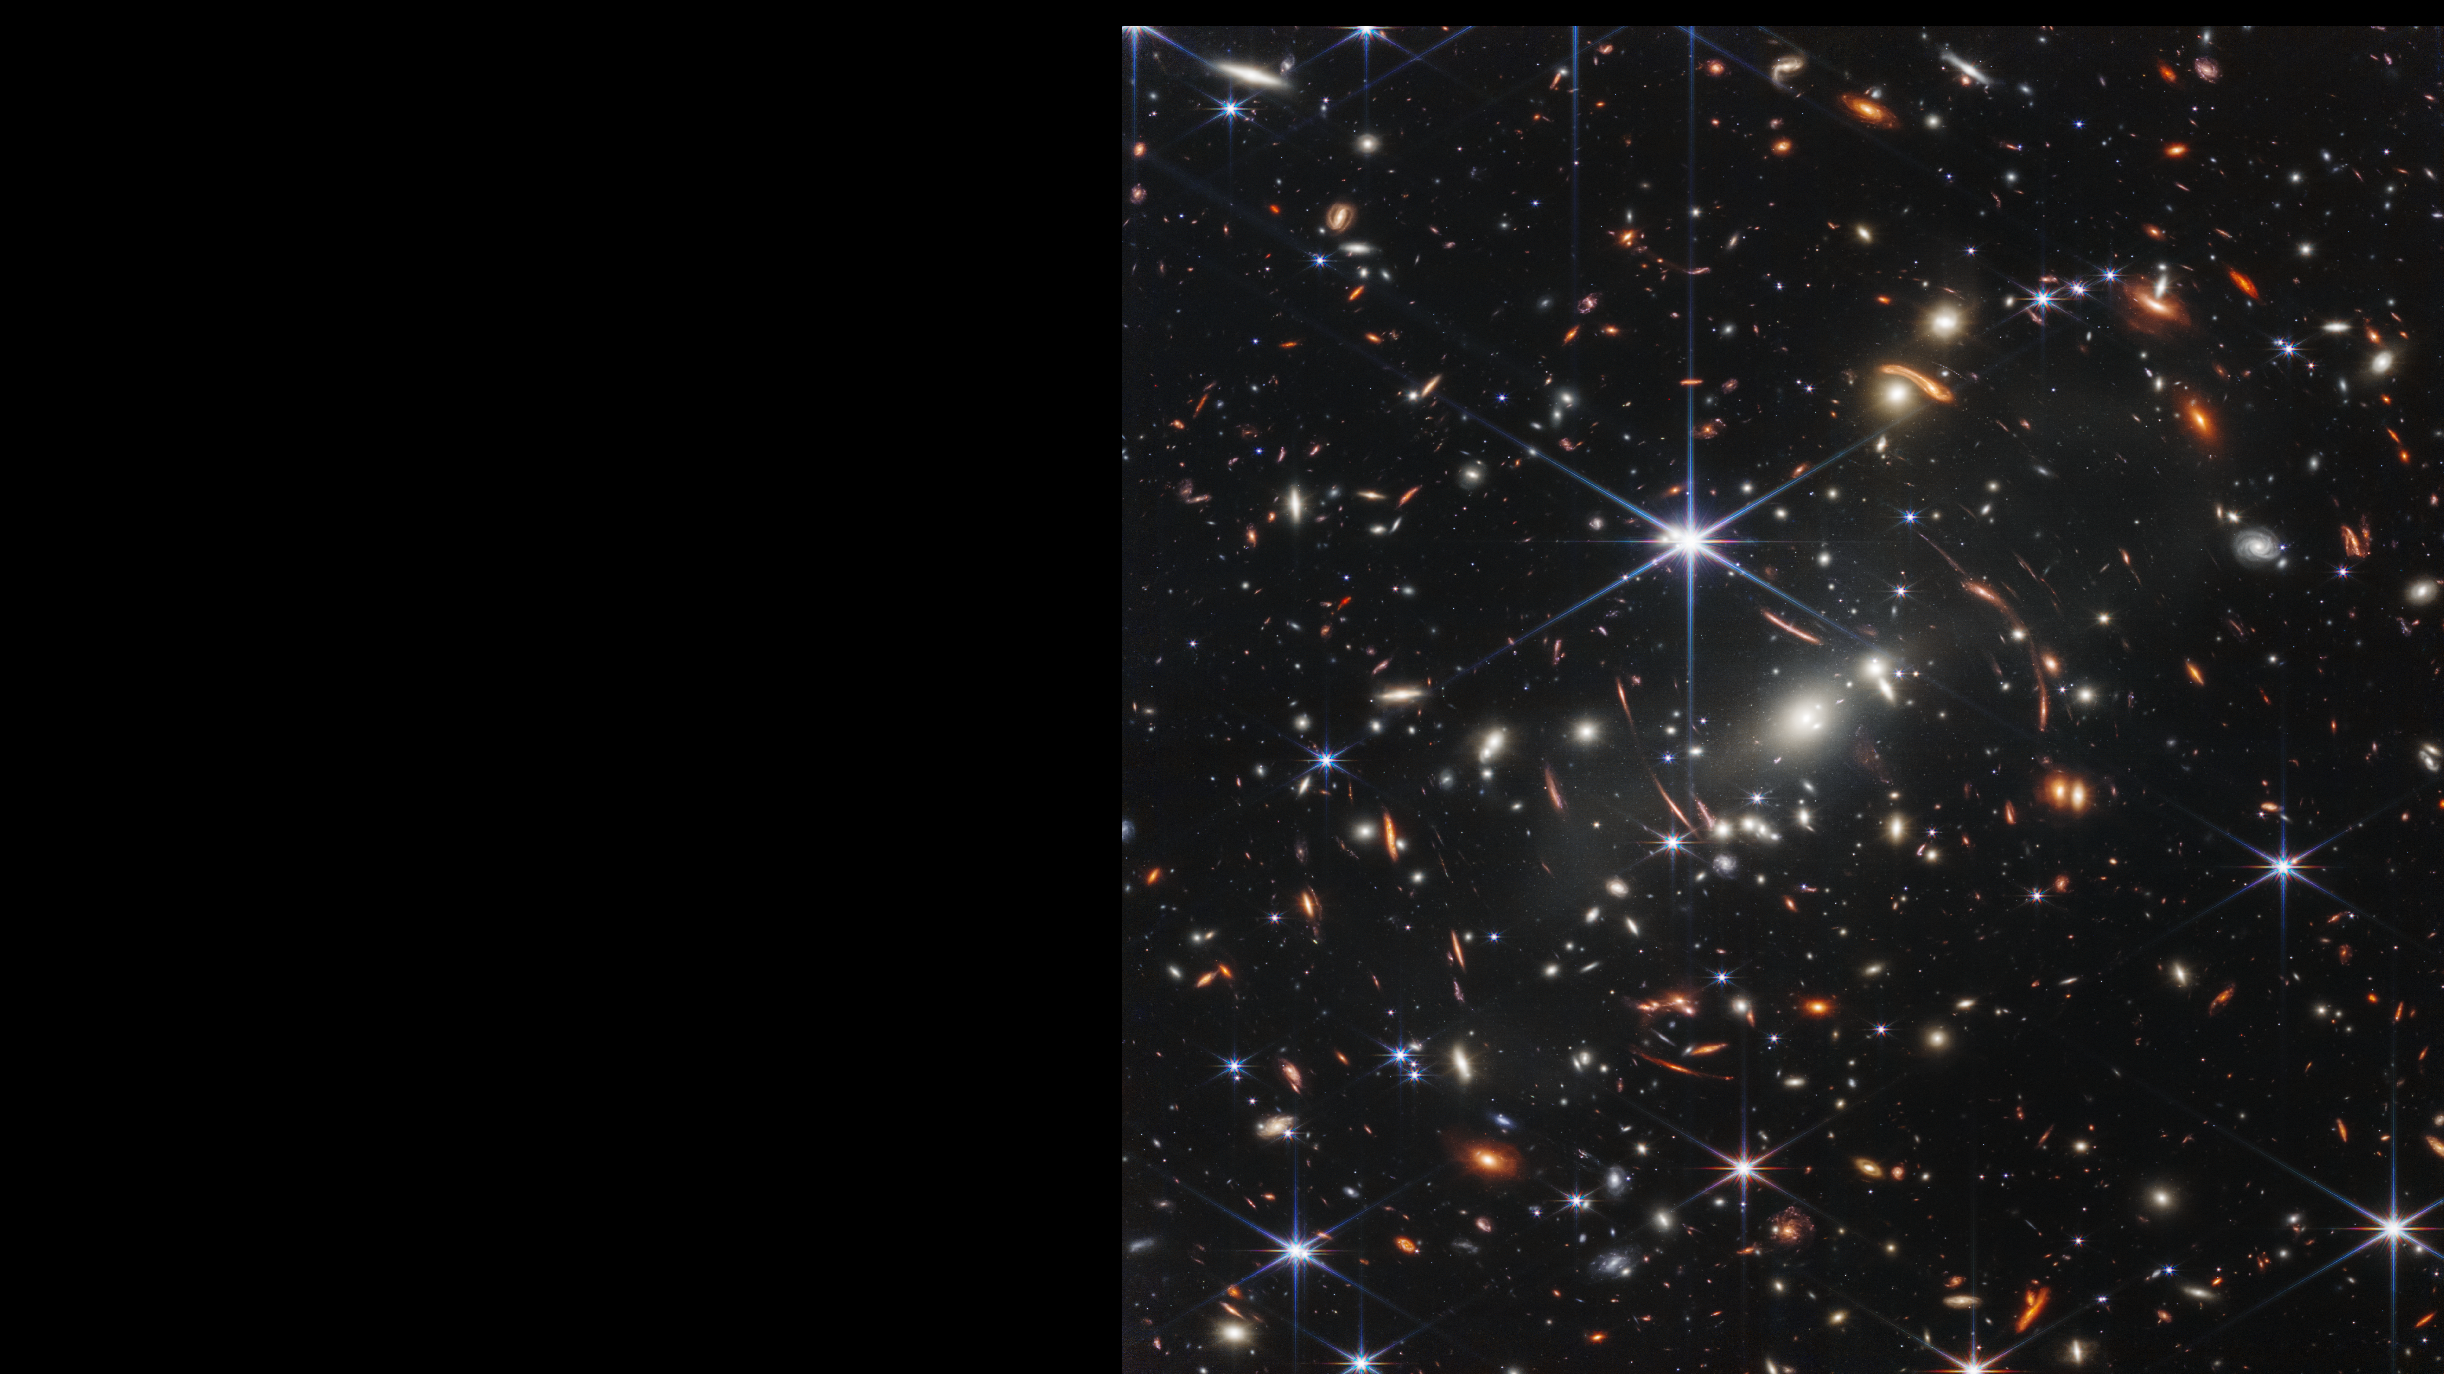
Webb’s First Deep Field
SMACS 0723
Near-Infrared Light
NIRCam Image
Notes:
NASA’s James Webb Space Telescope has delivered the deepest and sharpest infrared image of the distant universe so far. Affectionately known as Webb’s First Deep Field, this is galaxy cluster SMACS 0723 and it is teeming with thousands of galaxies – including the smallest, faintest objects ever observed.
Webb’s image is approximately the size of a grain of sand held at arm’s length, a tiny sliver of the vast universe. The combined mass of this galaxy cluster acts as a gravitational lens, magnifying more distant galaxies, including some seen when the universe was less than a billion years old. This deep field, taken by Webb’s Near-Infrared Camera (NIRCam), is a composite made from images at different wavelengths, totaling 12.5 hours – achieving depths at infrared wavelengths beyond the Hubble Space Telescope’s deepest fields, which took weeks. And this is only the beginning. Researchers will continue to use Webb to take longer exposures, revealing more of our vast universe.
This image shows the galaxy cluster SMACS 0723 as it appeared 4.6 billion years ago, with many more galaxies in front of and behind the cluster. Much more about this cluster will be revealed as researchers begin digging into Webb’s data. This field was also imaged by Webb’s Mid-Infrared Instrument (MIRI), which observes mid-infrared light.
Webb’s NIRCam has brought distant galaxies into sharp focus – they have tiny, faint structures that have never been seen before, including star clusters and diffuse features.
Light from these galaxies took billions of years to reach us. We are looking back in time to within a billion years after the big bang when viewing the youngest galaxies in this field. The light was stretched by the expansion of the universe to infrared wavelengths that Webb was designed to observe. Researchers will soon begin to learn more about the galaxies’ masses, ages, histories, and compositions.
Other features include the prominent arcs in this field. The powerful gravitational field of a galaxy cluster can bend the light rays from more distant galaxies behind it, just as a magnifying glass bends and warps images. Stars are also captured with prominent diffraction spikes, as they appear brighter at shorter wavelengths.
Webb’s MIRI image offers a kaleidoscope of colors and highlights where the dust is – a major ingredient for star formation, and ultimately life itself. Blue galaxies contain stars, but very little dust. The red objects in this field are enshrouded in thick layers of dust. Green galaxies are populated with hydrocarbons and other chemical compounds. Researchers will be able to use data like these to understand how galaxies form, grow, and merge with each other, and in some cases why they stop forming stars altogether.
In addition to taking images, two of Webb’s instruments also obtained spectra – data that reveal objects’ physical and chemical properties that will help researchers identify many more details about distant galaxies in this field. Webb’s Near Infrared Spectrograph (NIRSpec) microshutter array observed 48 individual galaxies at the same time – a new technology used for the first time in space – returning a full suite of details about each. The data revealed light from one galaxy that traveled for 13.1 billion years before Webb’s mirrors captured it. NIRSpec data also demonstrate how detailed galaxy spectra will be with Webb observations.
Finally, Webb’s Near-Infrared Imager and Slitless Spectrograph (NIRISS) used Wide-Field Slitless Spectroscopy to capture spectra of all the objects in the entire field of view at once. Among the results, it proves that one of the galaxies has a mirror image.
SMACS 0723 can be viewed near the constellation Volans in the southern sky.
The James Webb Space Telescope is the world's premier space science observatory. Webb will solve mysteries in our solar system, look beyond to distant worlds around other stars, and probe the mysterious structures and origins of our universe and our place in it. Webb is an international program led by NASA with its partners, ESA (European Space Agency) and CSA (Canadian Space Agency).
NASA Headquarters oversees the mission for the agency’s Science Mission Directorate. NASA’s Goddard Space Flight Center in Greenbelt, Maryland, manages Webb for the agency and oversees work on the mission performed by the Space Telescope Science Institute, Northrop Grumman, and other mission partners. In addition to Goddard, several NASA centers contributed to the project, including the agency’s Johnson Space Center in Houston, Jet Propulsion Laboratory (JPL) in Southern California, Marshall Space Flight Center in Huntsville, Alabama, Ames Research Center in California’s Silicon Valley, and others.
NIRCam was built by a team at the University of Arizona and Lockheed Martin’s Advanced Technology Center.
MIRI was contributed by ESA and NASA, with the instrument designed and built by a consortium of nationally funded European Institutes (the MIRI European Consortium) in partnership with JPL and the University of Arizona.
NIRISS was contributed by CSA. The instrument was designed and built by Honeywell in collaboration with the Université de Montréal and the National Research Council Canada.
NIRSpec was built for ESA by a consortium of European companies led by Airbus Defence and Space (ADS) with NASA’s Goddard Space Flight Center providing its detector and micro-shutter subsystems.
For a full array of Webb’s first images and spectra, including downloadable files, please visit: https://webbtelescope.org/news/first-images
Credits: NASA, ESA, CSA, and STScI
__________________________
Release: NASA’s Webb Delivers Deepest Image of Universe Yet
https://webbtelescope.org/contents/news-releases/2022/news-2022-035
Images:
Webb's First Deep Field SMACS 0723 (NIRCam Image): https://webbtelescope.org/contents/media/images/2022/035/01G7DCWB7137MYJ05CSH1Q5Z1Z
Webb's First Deep Field SMACS 0723 (MIRI and NIRCam Image): https://webbtelescope.org/contents/media/images/2022/035/01G7DDDR3P8ZW10HD8MKXGV8MJ
Webb's First Deep Field SMACS 0723 (MIRI and NIRCam Compass Image): https://webbtelescope.org/contents/media/images/2022/035/01G7DDWW7FSRX0GAP43WFZ9JNH
Webb’s First Deep Field (NIRISS Emission Spectra): https://webbtelescope.org/contents/media/images/2022/035/01G7HRMY93K0BCCBKCABAQH0V7
Webb’s First Deep Field (NIRSpec Emission Spectra): https://webbtelescope.org/contents/media/images/2022/035/01G7HRYVGM1TKW556NVJ1BHPDZ
Webb’s First Deep Field (NIRSpec Emission Spectrum): https://webbtelescope.org/contents/media/images/2022/035/01G7F33FYJY94B9H7FW1APV030
Resources:
Instruments: Near-Infrared Camera (NIRCam): https://webb.nasa.gov/content/observatory/instruments/nircam.html
Instruments: Near Infrared Spectrograph (NIRSpec): https://webb.nasa.gov/content/observatory/instruments/nirspec.html
Instruments: Fine Guidance Sensor/ Near Infrared Imager And Slitless Spectrograph (FGS/NIRISS): https://jwst.nasa.gov/content/observatory/instruments/fgs.html
Instruments: Mid-Infrared Instrument (MIRI): https://webb.nasa.gov/content/observatory/instruments/miri.html
Webb’s scientific instruments overview: https://webbtelescope.org/news/webb-science-writers-guide/webbs-scientific-instruments
Infographic, “Webb’s Diffraction Spikes”: https://webbtelescope.org/contents/media/images/01G529MX46J7AFK61GAMSHKSSN
Article, “Galaxies Over Time”: https://webbtelescope.org/webb-science/galaxies-over-time
Video, “Galaxies Through Time”: https://webbtelescope.org/contents/media/videos/2020/49/1290-Video
Video, “Galaxy Development Across Cosmic Distance”: https://webbtelescope.org/contents/media/videos/01G6WZ1QXJDMGHXP8AJA4RSVPF
Infographic, “Galaxies’ Spectra: Detailed Information Delivered by Light”: https://webbtelescope.org/contents/media/images/01G3CFMP9ZH6A5182B7NFN46DS
Six-part article series about spectroscopy: https://webbtelescope.org/resource-gallery/articles/pagecontent/filter-articles/spectroscopy-101--introduction
Video, “Reading the Rainbow: Distance”: https://webbtelescope.org/contents/media/videos/01F9KWWZTF1BKZ665759X2V2V1

Slide 28
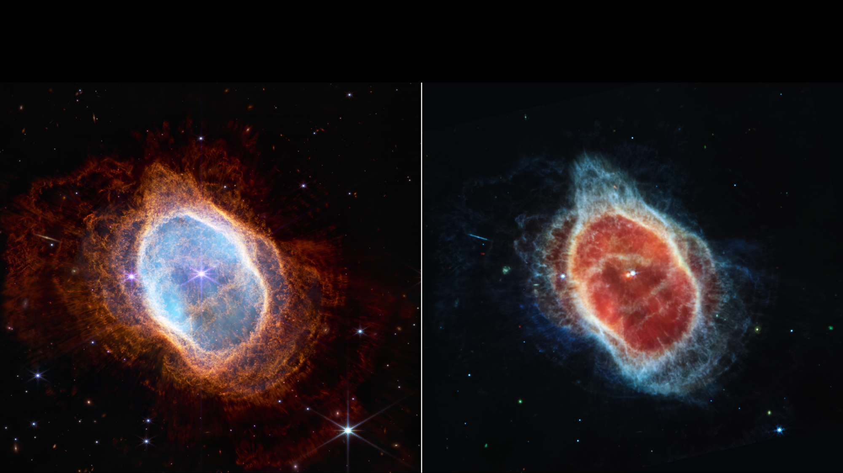
Planetary Nebula ׀ Southern Ring Nebula
Near-Infrared Light
NIRCam Image
Mid-Infrared Light
MIRI Image
Notes:
Some stars save the best for last.
The dimmer star at the center of this scene has been sending out rings of gas and dust for thousands of years in all directions, and NASA’s James Webb Space Telescope has revealed for the first time that this star is cloaked in dust.
Two cameras aboard Webb captured the latest image of this planetary nebula, cataloged as NGC 3132, and known informally as the Southern Ring Nebula. It is approximately 2,500 light-years away.
Webb will allow astronomers to dig into many more specifics about planetary nebulae like this one – clouds of gas and dust expelled by dying stars. Understanding which molecules are present, and where they lie throughout the shells of gas and dust will help researchers refine their knowledge of these objects.
This observation shows the Southern Ring Nebula almost face-on, but if we could rotate it to view it edge-on, its three-dimensional shape would more clearly look like two bowls placed together at the bottom, opening away from one another with a large hole at the center.
Two stars, which are locked in a tight orbit, shape the local landscape. Webb's infrared images feature new details in this complex system. The stars – and their layers of light – are prominent in the image from Webb’s Near-Infrared Camera (NIRCam) on the left, while the image from Webb’s Mid-Infrared Instrument (MIRI) on the right shows for the first time that the second star is surrounded by dust. The brighter star is in an earlier stage of its stellar evolution and will probably eject its own planetary nebula in the future.
In the meantime, the brighter star influences the nebula’s appearance. As the pair continues to orbit one another, they “stir the pot” of gas and dust, causing asymmetrical patterns.
Each shell represents an episode where the fainter star lost some of its mass. The widest shells of gas toward the outer areas of the image were ejected earlier. Those closest to the star are the most recent. Tracing these ejections allows researchers to look into the history of the system.
Observations taken with NIRCam also reveal extremely fine rays of light around the planetary nebula. Starlight from the central stars streams out where there are holes in the gas and dust – like sunlight through gaps in a cloud.
Since planetary nebulae exist for tens of thousands of years, observing the nebula is like watching a movie in exceptionally slow motion. Each shell the star puffed off gives researchers the ability to precisely measure the gas and dust that are present within it.
As the star ejects shells of material, dust and molecules form within them – changing the landscape even as the star continues to expel material. This dust will eventually enrich the areas around it, expanding into what’s known as the interstellar medium. And since it’s very long-lived, the dust may end up traveling through space for billions of years and become incorporated into a new star or planet.
In thousands of years, these delicate layers of gas and dust will dissipate into surrounding space.
The James Webb Space Telescope is the world's premier space science observatory. Webb will solve mysteries in our solar system, look beyond to distant worlds around other stars, and probe the mysterious structures and origins of our universe and our place in it. Webb is an international program led by NASA with its partners, ESA (European Space Agency) and the Canadian Space Agency.
NASA Headquarters oversees the mission for the agency’s Science Mission Directorate. NASA’s Goddard Space Flight Center in Greenbelt, Maryland, manages Webb for the agency and oversees work on the mission performed by the Space Telescope Science Institute, Northrop Grumman, and other mission partners. In addition to Goddard, several NASA centers contributed to the project, including the agency’s Johnson Space Center in Houston, Jet Propulsion Laboratory in Southern California, Marshall Space Flight Center in Huntsville, Alabama, Ames Research Center in California’s Silicon Valley, and others.
For a full array of Webb’s first images and spectra, including downloadable files, please visit: https://webbtelescope.org/news/first-images
Credit: NASA, ESA, CSA, and STScI
__________________________
Release: NASA’s Webb Captures Dying Star’s Final ‘Performance’ in Fine Detail
https://webbtelescope.org/contents/news-releases/2022/news-2022-033
Images:
Southern Ring Nebula (NIRCam and MIRI Images Side by Side) : https://webbtelescope.org/contents/media/images/2022/033/01G709QXZPFH83NZFAFP66WVCZ
Southern Ring Nebula (NIRCam Image): https://webbtelescope.org/contents/media/images/2022/033/01G70BGTSYBHS69T7K3N3ASSEB
Southern Ring Nebula (MIRI Image): https://webbtelescope.org/contents/media/images/2022/033/01G70C5F6Z698YC9E1DEBA3WET
Southern Ring Nebula (NIRCam Compass Image): https://webbtelescope.org/contents/media/images/2022/033/01G70Q10ATNZ3W0Z7MPVD9D4BE
Southern Ring Nebula (MIRI Compass Image): https://webbtelescope.org/contents/media/images/2022/033/01G70SN4XRZCDVQWB2DN844VFR
Resources:
Instruments: Near-Infrared Camera (NIRCam): https://webb.nasa.gov/content/observatory/instruments/nircam.html
Instruments: Webb’s Mid-Infrared Instrument (MIRI): https://webb.nasa.gov/content/observatory/instruments/miri.html
Clickable ViewSpace interactive: Star Death: Helix Nebula
https://viewspace.org/interactives/unveiling_invisible_universe/star_death/helix_nebula
ViewSpace Image Tour: The Cat's Eye Nebula: https://viewspace.org/video_library/videos/21-322867512
Video, “Infrared Universe: Helix Nebula”:
https://webbtelescope.org/contents/media/videos/1102-Video
AstroPix, astronomical image search for “NGC 3132”, the Southern Ring Nebula:
https://astropix.ipac.caltech.edu/search?q=NGC+3132&radius=0.2

Slide 29
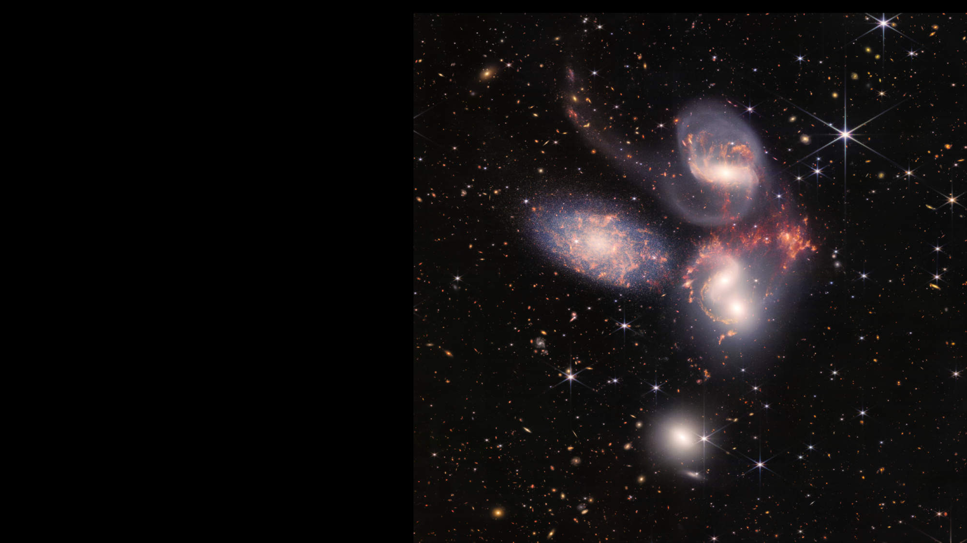
Interacting Galaxies Stephan’s Quintet
Near- and Mid-Infrared Light
Combined NIRCam and MIRI Image
Notes:
Stephan’s Quintet, a visual grouping of five galaxies, is best known for being prominently featured in the holiday classic film, “It’s a Wonderful Life.” Today, NASA’s James Webb Space Telescope reveals Stephan’s Quintet in a new light. This enormous mosaic is Webb’s largest image to date, covering about one-fifth of the Moon’s diameter. It contains over 150 million pixels and is constructed from almost 1,000 separate image files. The information from Webb provides new insights into how galactic interactions may have driven galaxy evolution in the early universe.
With its powerful, infrared vision and extremely high spatial resolution, Webb shows never-before-seen details in this galaxy group. Sparkling clusters of millions of young stars and starburst regions of fresh star birth grace the image. Sweeping tails of gas, dust and stars are being pulled from several of the galaxies due to gravitational interactions. Most dramatically, Webb captures huge shock waves as one of the galaxies, NGC 7318B, smashes through the cluster.
Together, the five galaxies of Stephan’s Quintet are also known as the Hickson Compact Group 92 (HCG 92). Although called a “quintet,” only four of the galaxies are truly close together and caught up in a cosmic dance. The fifth and leftmost galaxy, called NGC 7320, is well in the foreground compared with the other four. NGC 7320 resides 40 million light-years from Earth, while the other four galaxies (NGC 7317, NGC 7318A, NGC 7318B, and NGC 7319) are about 290 million light-years away. This is still fairly close in cosmic terms, compared with more distant galaxies billions of light-years away. Studying such relatively nearby galaxies like these helps scientists better understand structures seen in a much more distant universe.
This proximity provides astronomers a ringside seat for witnessing the merging and interactions between galaxies that are so crucial to all of galaxy evolution. Rarely do scientists see in so much detail how interacting galaxies trigger star formation in each other, and how the gas in these galaxies is being disturbed. Stephan’s Quintet is a fantastic “laboratory” for studying these processes fundamental to all galaxies.
Tight groups like this may have been more common in the early universe when their superheated, infalling material may have fueled very energetic black holes called quasars. Even today, the topmost galaxy in the group – NGC 7319 – harbors an active galactic nucleus, a supermassive black hole 24 million times the mass of the Sun. It is actively pulling in material and puts out light energy equivalent to 40 billion Suns.
Webb studied the active galactic nucleus in great detail with the Near-Infrared Spectrograph (NIRSpec) and Mid-Infrared Instrument (MIRI). These instruments’ integral field units (IFUs) – which are a combination of a camera and spectrograph – provided the Webb team with a “data cube,” or collection of images of the galactic core’s spectral features.
Much like medical magnetic resonance imaging (MRI), the IFUs allow scientists to “slice and dice” the information into many images for detailed study. Webb pierced through the shroud of dust surrounding the nucleus to reveal hot gas near the active black hole and measure the velocity of bright outflows. The telescope saw these outflows driven by the black hole in a level of detail never seen before.
In NGC 7320, the leftmost and closest galaxy in the visual grouping, Webb was able to resolve individual stars and even the galaxy’s bright core.
As a bonus, Webb revealed a vast sea of thousands of distant background galaxies reminiscent of Hubble’s Deep Fields.
Combined with the most detailed infrared image ever of Stephan’s Quintet from MIRI and the Near-Infrared Camera (NIRCam), the data from Webb will provide a bounty of valuable, new information. For example, it will help scientists understand the rate at which supermassive black holes feed and grow. Webb also sees star-forming regions much more directly, and it is able to examine emission from the dust – a level of detail impossible to obtain until now.
Located in the constellation Pegasus, Stephan’s Quintet was discovered by the French astronomer Édouard Stephan in 1877.
The James Webb Space Telescope is the world's premier space science observatory. Webb will solve mysteries in our solar system, look beyond to distant worlds around other stars, and probe the mysterious structures and origins of our universe and our place in it. Webb is an international program led by NASA with its partners, ESA (European Space Agency) and the Canadian Space Agency.
NASA Headquarters oversees the mission for the agency’s Science Mission Directorate. NASA’s Goddard Space Flight Center in Greenbelt, Maryland, manages Webb for the agency and oversees work on the mission performed by the Space Telescope Science Institute, Northrop Grumman, and other mission partners. In addition to Goddard, several NASA centers contributed to the project, including the agency’s Johnson Space Center in Houston, Jet Propulsion Laboratory in Southern California, Marshall Space Flight Center in Huntsville, Alabama, Ames Research Center in California’s Silicon Valley, and others.
NIRCam was built by a team at the University of Arizona and Lockheed Martin’s Advanced Technology Center.
MIRI was contributed by ESA and NASA, with the instrument designed and built by a consortium of nationally funded European Institutes (The MIRI European Consortium) in partnership with JPL and the University of Arizona.
NIRSpec was built for the European Space Agency (ESA) by a consortium of European companies led by Airbus Defence and Space (ADS) with NASA’s Goddard Space Flight Center providing its detector and micro-shutter subsystems.
For a full array of Webb’s first images and spectra, including downloadable files, please visit: https://webbtelescope.org/news/first-images
Credits: NASA, ESA, CSA, and STScI
__________________________
Release: NASA’s Webb Sheds Light on Galaxy Evolution, Black Holes
https://webbtelescope.org/contents/news-releases/2022/news-2022-034
Images:
Stephan's Quintet (NIRCam and MIRI Composite Image): https://webbtelescope.org/contents/media/images/2022/034/01G7DA5ADA2WDSK1JJPQ0PTG4A
Stephan's Quintet (MIRI Image): https://webbtelescope.org/contents/media/images/2022/034/01G7DBCJA1M1SSGKDMH7F5XMBE
Stephan's Quintet (MIRI Spectra): https://webbtelescope.org/contents/media/images/2022/034/01G7F6AWJNTF1G0ZWP5ESGSFXF
Stephan's Quintet (NIRSpec IFU): https://webbtelescope.org/contents/media/images/2022/034/01G7FJFCNKGARKRFM13FWQ881E
Stephan's Quintet (MIRI IFU): https://webbtelescope.org/contents/media/images/2022/034/01G7FG9P3BVP4CPK1QHX0RG5XN
Stephan's Quintet (NIRCam and MIRI Composite Compass Image): https://webbtelescope.org/contents/media/images/2022/034/01G7DBYV6PTE37PEB5TZ19TMV2
Stephan's Quintet (MIRI Compass Image): https://webbtelescope.org/contents/media/images/2022/034/01G7DCGA9539YTTMM0NC7M63K9
Resources:
Instruments: Near Infrared Spectrograph (NIRSpec): https://webb.nasa.gov/content/observatory/instruments/nirspec.html
Instruments: Webb’s Mid-Infrared Instrument (MIRI): https://webb.nasa.gov/content/observatory/instruments/miri.html
Clickable ViewSpace interactive: Interacting Galaxies: Future of the Milky Way:
https://viewspace.org/interactives/unveiling_invisible_universe/interacting_galaxies/future_of_the_milky_way
Article, “What Are Active Galactic Nuclei?”: https://webbtelescope.org/resource-gallery/articles/pagecontent/filter-articles/what-are-active-galactic-nuclei
Article, “NASA’s Webb Telescope Will Explore the Cores of Merging Galaxies”: https://webbtelescope.org/contents/news-releases/2020/news-2020-49
Infographic, “Dissecting Supermassive Black Holes”:
https://webbtelescope.org/contents/media/images/2021/015/01EZ5F0BYEP19BGPCZ7BMMCDGT
Video, “Dissecting Supermassive Black Holes: The Feedback Loop”:
https://webbtelescope.org/contents/media/videos/2021/015/01F09AQGN1JD1H8BJJZDR4RPWS
Video, “Dissecting Supermassive Black Holes: Pinpointing the Flows”:
https://webbtelescope.org/contents/media/videos/01F099WFKMGVB0B549DDBA4BAF
Video, “How Do Space Telescopes Break Down Light?” https://webbtelescope.org/contents/media/videos/2018/37/1181-Video
Video, “Reading the Rainbow: Speed”:
https://webbtelescope.org/contents/media/videos/01F9KWVZCV229ATG0NQCGA6TE0
AstroPix, astronomical image search for Stephan’s Quintet:
https://astropix.ipac.caltech.edu/search?dec=&q=Stephan’s+Quintet&ra=&radius=0.2

